Slide 1
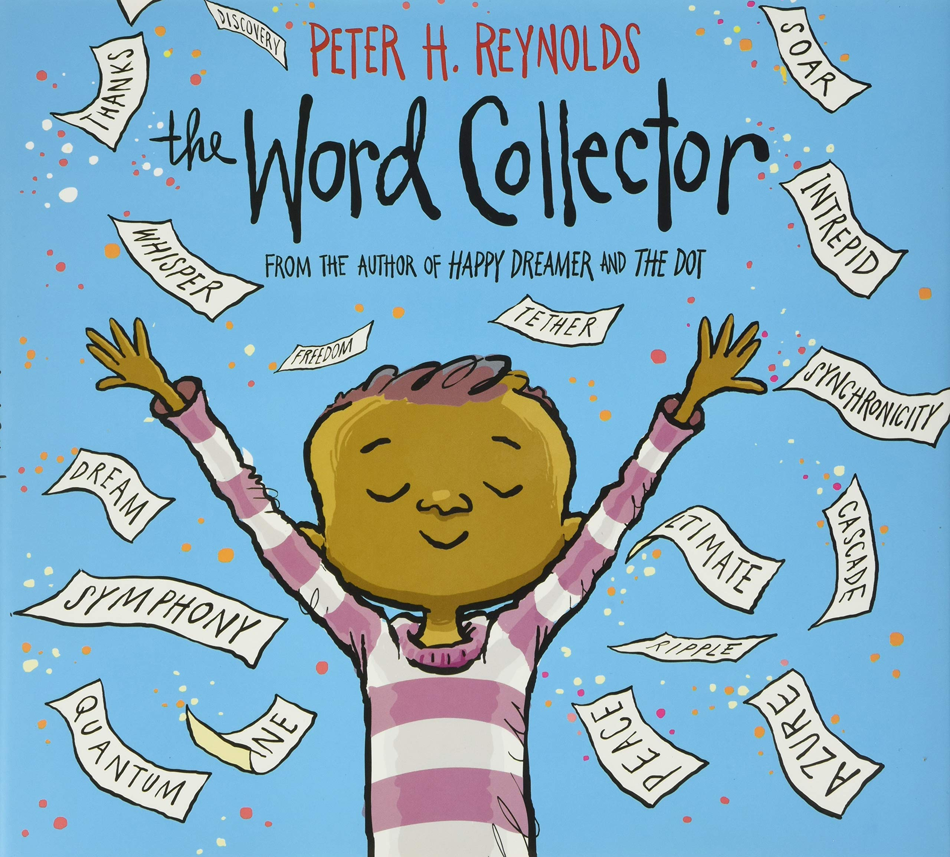
The Effervescent, Marvelously Perplexing Transformation of a Story Into a Mellifluous Experience
Allison Kummerfeldt and Susan Ahmad
Notes:
Pass out words and ask people to throw them

Slide 2
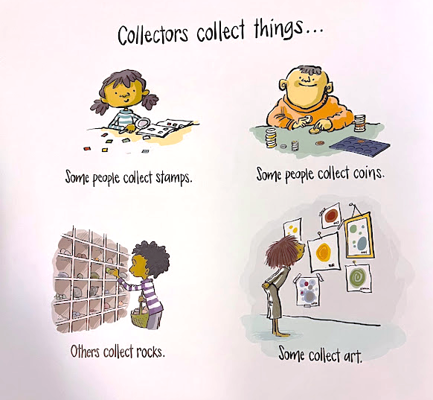
Notes:
(Allison) Some people like to collect things, like baseball cards, bugs, art, etc. What are some things you collect?

Slide 3
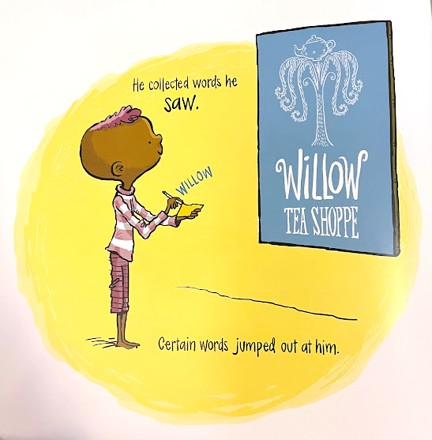
Notes:
Well Jerome, he liked to collect words. He would collect words from things he heard and saw... and anytime he found a word he loved for his collection he would write it down. He may not have known the meaning of all of the words he wrote, but they were all wonderful just the same.

Slide 4
Notes:
His collection grew and grew, and eventually became quite large. One day when walking, Jerome slipped! And his words went flying. (AirZooka and volunteers throw the words).

Slide 5
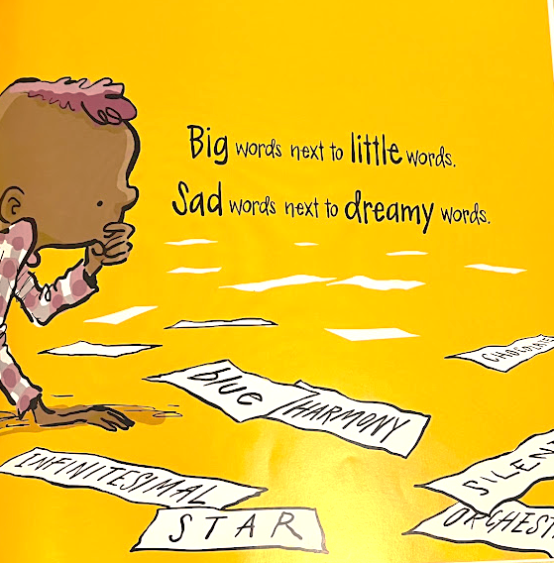
Notes:
When he bent down to pick them up he noticed that he loved how some of his words fit together. There were short words, long words, big words, little words, and multisyllable words that sounded like little songs. Some made sense together, and some did not, but to Jerome they were all wonderful just the same.

Slide 6
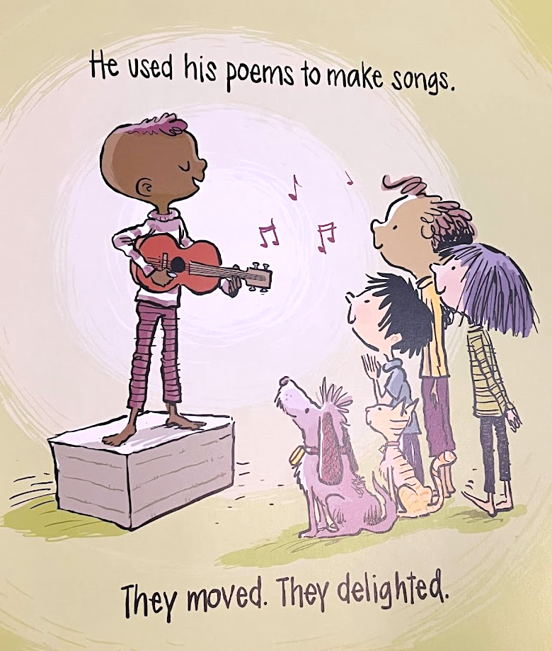
Notes:
He used his words to write poems and his poems to write songs, which moved and delighted. Sometimes some of his simplest words were his most powerful....like, I’m sorry, thank you, or you matter.

Slide 7
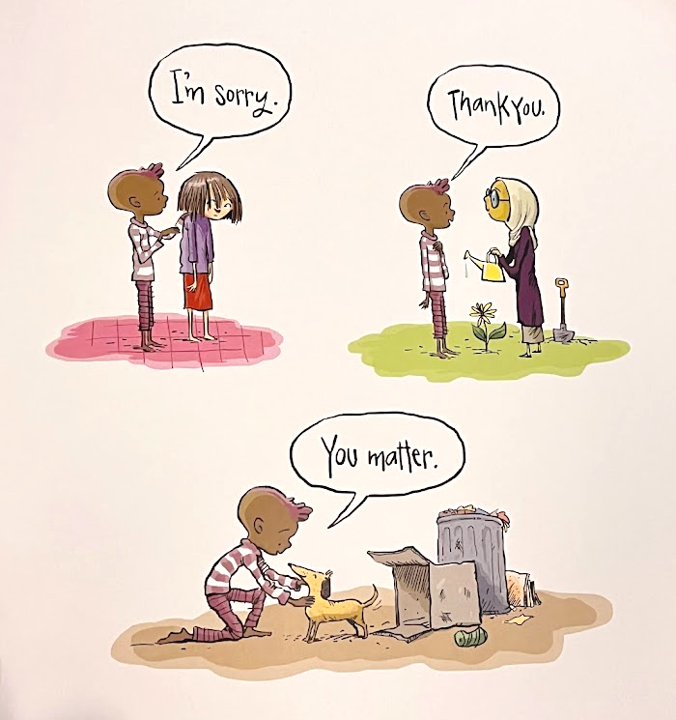
Notes:
The more words he knew, the more clearly he could share with the world what he was thinking, feeling, and dreaming.

Slide 8
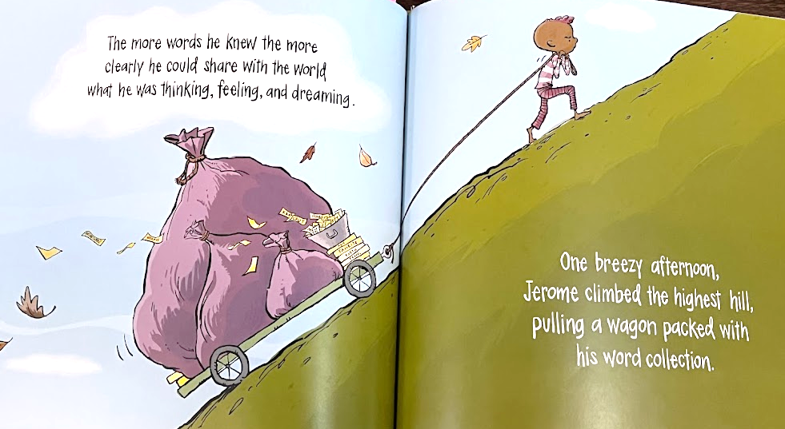
Notes:
One breezy day Jerome climbed the highest hill he could find, while pulling his packed word collection behind him in a wagon.

Slide 9
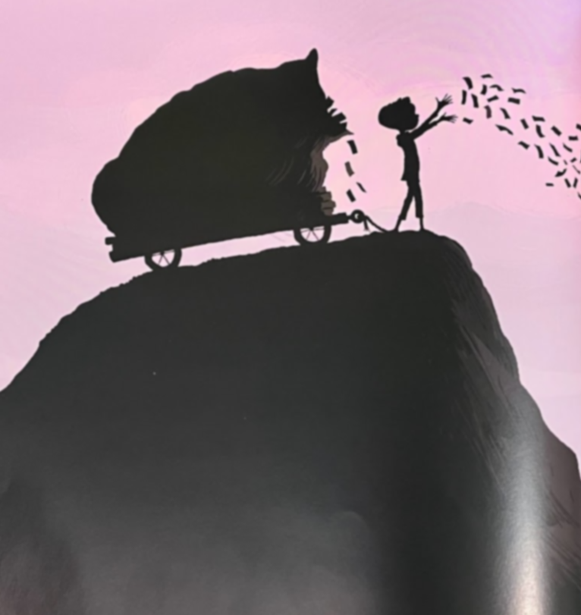
Notes:
He released the words into the valley below, where children excitedly caught and collected the words. Jerome had no words to describe how happy it made him. (Close Book)

Slide 10
It's time to find a new type of word. Which ones stand out as common, new, or unheard?
Notes:
(Susan) Repeat after me.....
It's time to find a new type of word. Which ones stand out as common, new, or unheard?
(Add steady beat patterns)

Slide 11
The Word Collector …Word Bank
One Syllable
Spark Bloom Light
Drift Dream Space
Smudge Breeze Truth
Soul Learn Goal
Wings Sad
Sport Roar Grace
Peace Lost Wish
Cloud Cloak Glow
Star Slide Hope
Two Syllable
Wonder Treasure
Whisper Glimmer
Million Crimson
Shimmer Brilliant
Ascend Dreamy
Action Friendly
Colors Funny
Motion Flowers
Weather Solar
Three Syllable
Four Syllable
Wonderful
Symphony
Marvelous
Torrential
Harmony
Poetic
Animals
Whispery
Serious
Possible
Universe
Guacamole
Kaleidoscope
Aromatic
Effervescent
Mysterious
Scientific
Equality
Everlasting
Notes:
Take a look at the words on the board. These are all of the words found in the book the word collector. In a moment, you will need to find a group of 5-7 people. Select a few words as a group from the word bank and create an eight beat rhythm pattern. Use creative movement to help your group remember your pattern. You can add props and/or rhythm instruments to your movements to enhance the experience. Your cue to give me your attention...will be woo woo woo....Let's practice...repeat after me woo woo woo. You may now select your groups and start working!

Slide 12
It's time to find a new type of word. Which ones stand out as common, new, or unheard? (Repeat)
Notes:
Woo Woo Woo....let's perform our chant. We will all say the A section while keeping the steady beat and when we come to your group....you will perform your B section. Try to keep the steady beat in a unique way. Let's practice the A section

Slide 13
Notes:
Here is a different way to do the same activity. The students holding the drums keep the steady beat while the other students travel and end at a drum during the A section. They then play the rhythm for the B section.

Slide 14
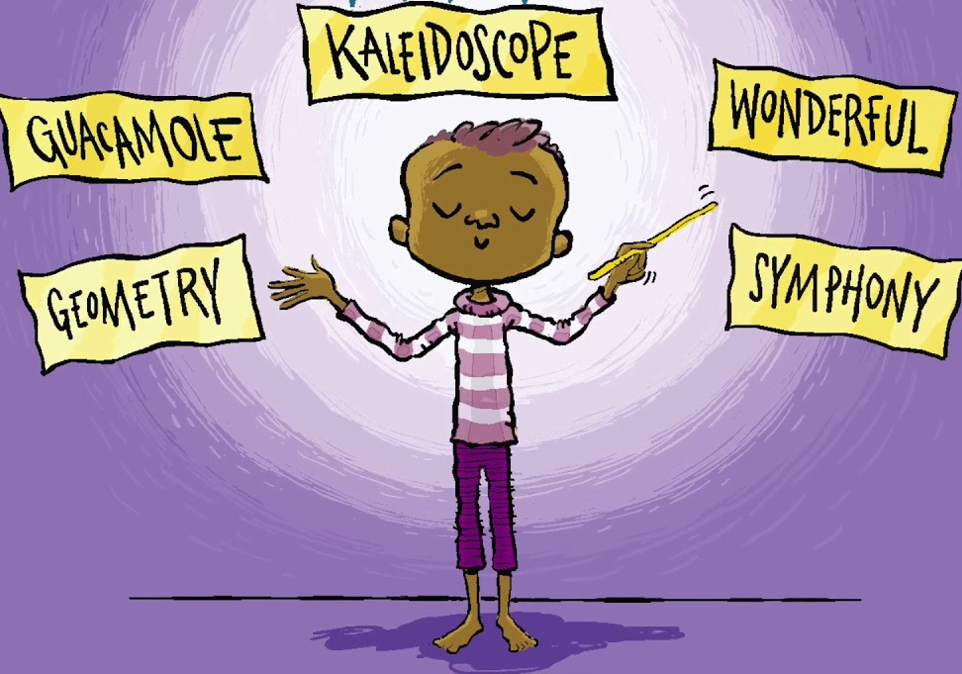
Notes:
(Allison) You know words are perplexing, aren’t they? We use them to read, sing, speak, and write. We see, hear, and can even feel them. I feel like words can just ignite something inside of us.

Slide 15
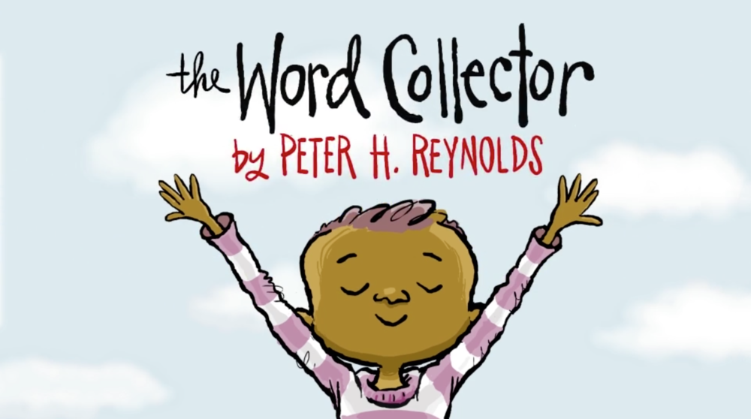
Words are perplexing
Used to read, sing, speak, and write
See, hear, and feel them
Let the words ignite
Notes:
Sing song, rote teach

Slide 16
Notes:
I am sure you have noticed there are words all over the ground. We are going to divide into new teams of 5-7 people. Your team will grab either 4 or 8 words total, with the last word having one syllable. If you choose 8 words you will read your pattern once. If you choose 4 words, you will read your pattern twice. You may notice that there are blank papers as well. You can write your own words to add to your word chain, or use existing words that my students produced. Write you first and last name on the back of one of these words. We will collect and use these papers later to draw for prizes at the end of our presentation!

Slide 17
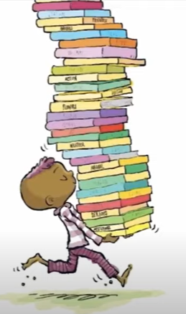
Make a Word Chain
Groups of 5-7ish.
Pick 4 or 8 words total, with the last word being a one syllable word.
Figure out the rhythm of your words from the syllables of the words, then string them together for 16 beats total (example below). If 16 is too many beats to remember, choose 4 words and repeat the set of 4 twice (8+8)
Once you have your pattern of words and the rhythms, practice your pattern. Your group can choose how to remember it. Add Body Percussion, say and clap, use movements, it is your choice! Most important part to remember is the rhythm.
Donut inspiration alligator mud
Ukulele firework encouraging brave
Notes:
Once you have your words, figure out your pattern and practice reading it. Next, add body percussion to your pattern.

Slide 18
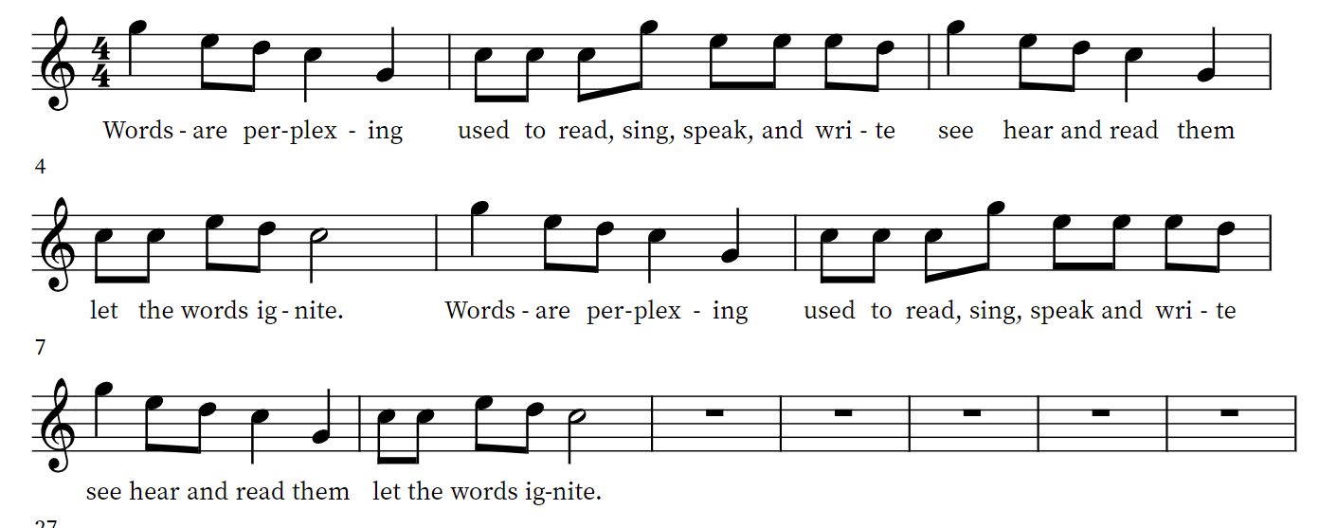
Melody
feel
feel
Notes:
Can we have some volunteers head to instruments, set up C pentatoni? Take a few minutes to learn to play the melody. Let's all play the melody together.

Slide 19
Bass Line
Notes:
The bass line is simple. It is C and G low and then high.

Slide 20
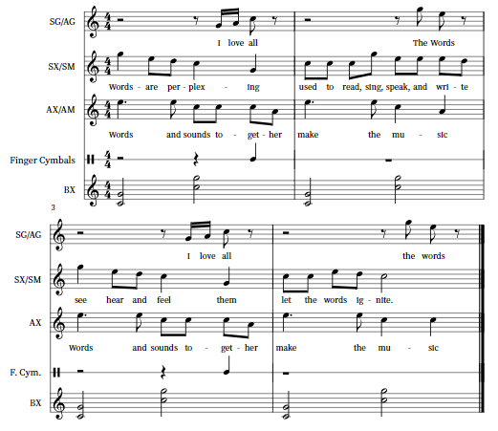
Finger Cymbal at very end!
Notes:
Now for Both parts together

Slide 21
Alto Line
Notes:
Please sing after me....Words and sounds together make the music

Slide 22
Finger Cymbal at very end!
Notes:
Let's play the three parts together

Slide 23
Ostinato
Notes:
It is time to Add the Glock, 1.2.3...I love all, 1.2.3 the words!
Finger Cymbals

Slide 24
Finger Cymbal at very end!
Notes:
We are going to layer the parts in and them perform the song two times.

Slide 25
B Section!
Basses continue, everyone else drop out.
Guided Improvisation
Play your rhythm/word chain, but you choose the notes. Make your last note C.
Final Form, Intro A A B… A B.. A (or whatever you would like it to be)
Notes:
B section
Now we get to improvise! Play your rhythm chain, 16 beats total, everybody pick one note and play their rhythm chain on that one note. end on C/one syllable word. Explain that with students I would add another note so they can improvise on two neighboring notes, then 3, then all five within one octave of the pentatonic scale. Since you all are educators, you can just jump right into the last step of using any notes on the instrument, playing your rhythm chain, and just landing on a C. If you mess up your rhythm chain or your improvisation, nobody will know!
Final Form, AAB…AB…A or whatever you decide it to be.

Slide 26
Other Activities
Notes:
(Susan) Here are some additional activities that you might like to use with your students

Slide 27
Level 1 -
Step 1: Write rhythm patterns
Step 2: Fix any mistakes
Step 3: Select words from the book that match the number of syllables for your rhythm patterns
Step 4: Practice reading your patterns
Level 2 –
Create movements to go with your patterns
Level 3 –
Compose a melody to go with your patterns (sing them)
Notes:
I used this one during our rhythm unit. (Read Steps)
Step 1: Write rhythm patterns
Step 2: Fix any mistakes
Step 3: Select words from the book that match the number of syllables for your rhythm patterns
Step 4: Practice reading your patterns
Level 2 –
Create movements to go with your patterns
Level 3 –
Create a melody to go with your patterns (sing them)

Slide 28
Notes:
We also had students think of a word that best describes them. They wrote their word on a slip of paper and wrote the rhythm that matches their word. We used these words to create amazing displays!

Slide 29
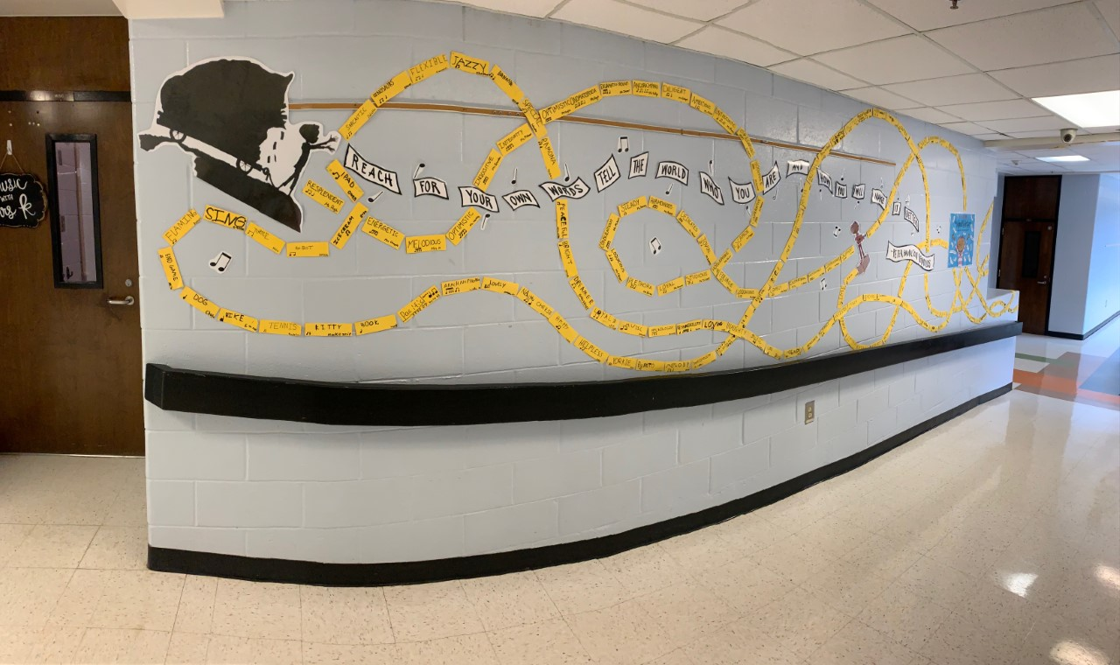
More coming soon!

Slide 32
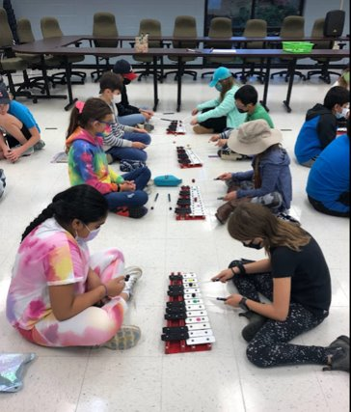
Orff Instrument Modifications
Shared instruments
Alternative instruments: Use drums for bass line, hand bells, boom whackers, singing, recorder for alto part, improvise on recorder, play C chord on ukulele or alternate C and G chords
Improvise with words instead of instruments
Notes:
Some of us don't have enough Orff instruments for our class to play at the same time. Here are some suggestions.
Share instruments...my students sat with an instrument between them and just turned them around to play. When they weren't playing they could help their partner.
You can also use Alternative instruments: Use drums for bass line, boom whackers, singing, recorder for alto part, improvise on recorder, play C chord on ukulele or alternate C and G chords
Improvise with words instead of instruments

Slide 33
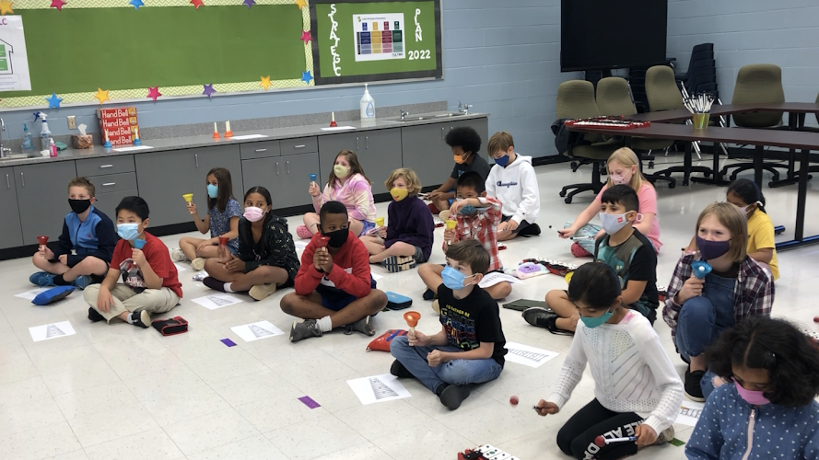
Print a paper instrument so while you are waiting to use the instruments you can still practice!
Use handbells with the whole class!
Notes:
You can even print a paper instrument so while you are waiting to use the instruments you can still practice using mallets and playing along on the paper!
Or use handbells with the whole class!

Slide 34
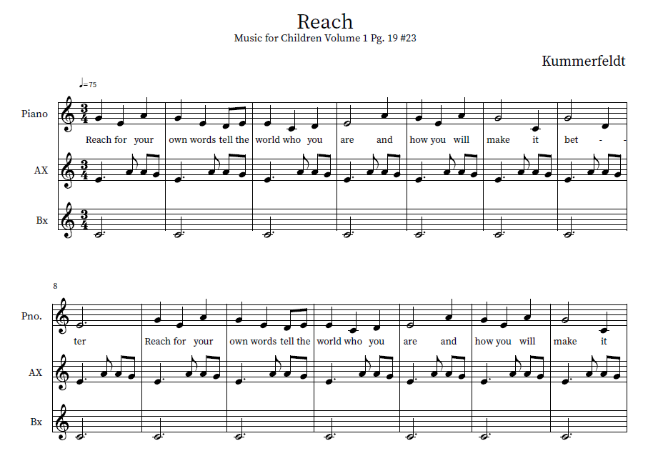
Notes:
Here is another Orff arrangement you can use with this book!

Slide 35
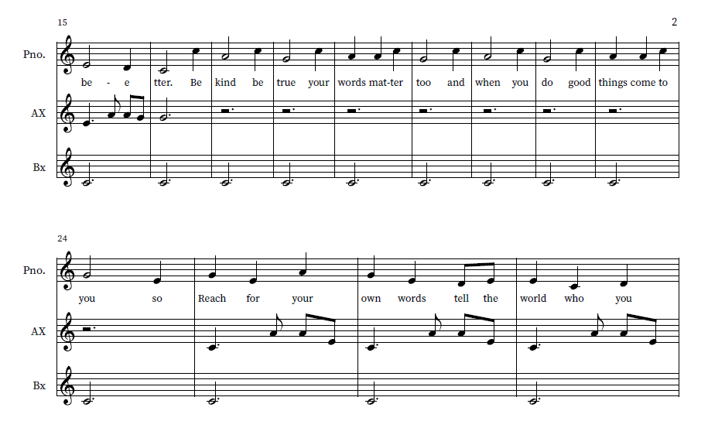

Slide 36
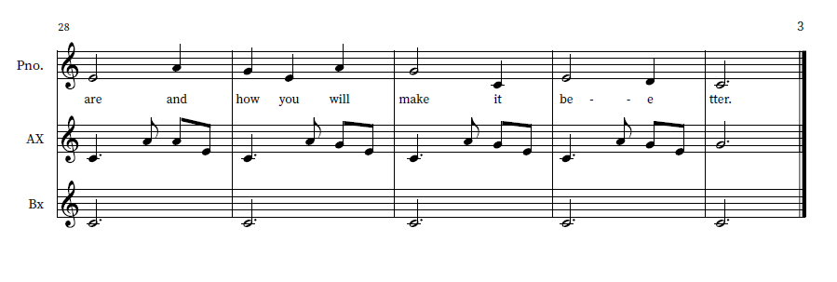
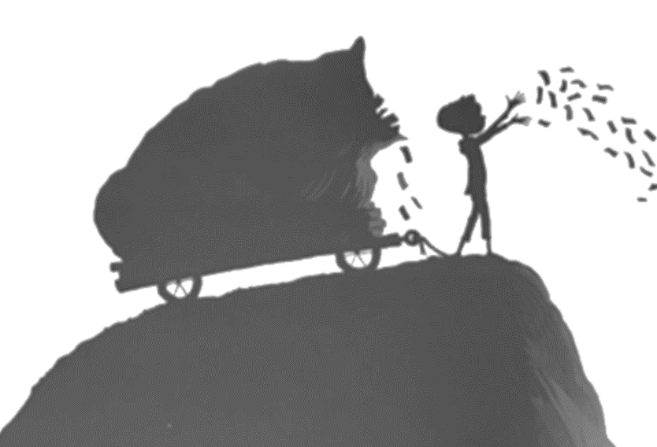

Slide 37
The Effervescent, Marvelously Perplexing Transformation of a Story Into a Mellifluous Experience
Allison Kummerfeldt
kummerfeldta@fultonschools.org
Susan Ahmad
ahmad@fultonschools.org
mrsahmadsmusicnotes.weebly.com
Notes:
We hope you enjoyed our presentation.... The Effervescent, Marvelously Perplexing Transformation of a Story Into a Mellifluous Experience
Our activities today were inspired by the book "The Word Collector" by: Peter H Reynolds
You can find our presentation on my website...Mrsahmadsmusicnotes.weebly.com
We are going to draw for prizes and then take questions.
Are there any questions?
word sets, ribbon wands
6 books, 3 BB words, 3 lights

