Slide 1
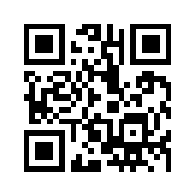
Kicking it Up a Notch What's the Big Deal about Rigor?
Susan Ahmad, Megan Endicott and Myra Wheat
Fulton County Schools

Slide 2
Academic Relevance
Personalized Learning
Critical Thinking Skills
Essential Questions
Depth of Knowledge
Blooms Taxonomy
Groups
Supplemental
Challenge Statements
Differentiated Instruction
Data Based Instruction
Higher Order Thinking Skills
Problem Based Learning
Remediation
Rigor

Slide 3
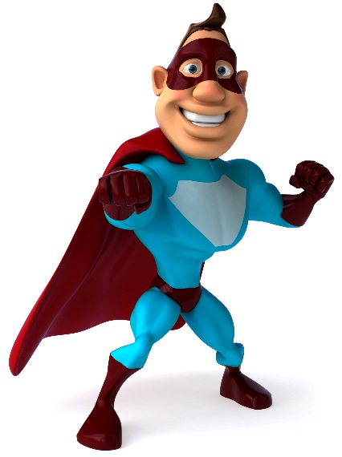
TO THE

Slide 4
https://www.youtube.com/watch?v=jkA7tbFoSUo

Slide 5
https://www.youtube.com/watch?v=j8JJ1F5svPs
Chicken on the Fence Post

Slide 6
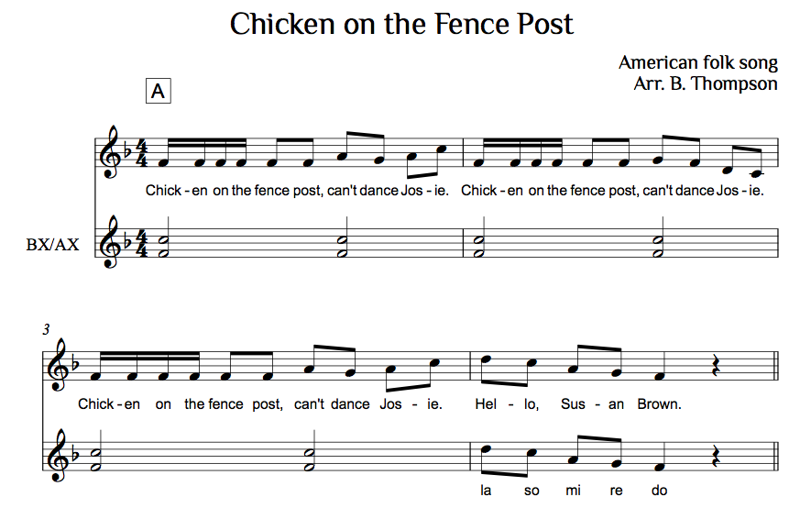
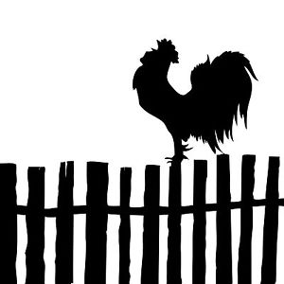

Slide 7
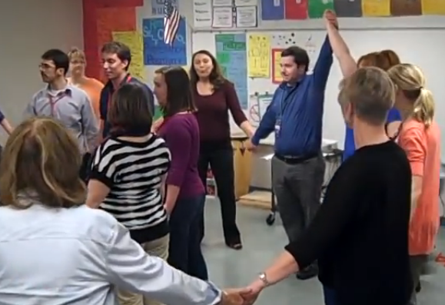
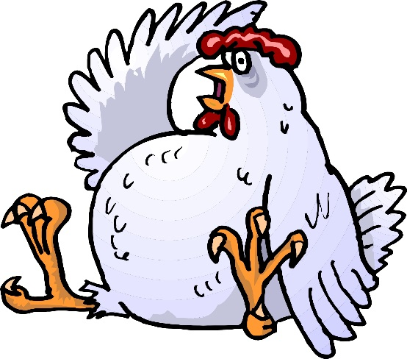
https://www.youtube.com/watch?v=m5m_ifwWzRI

Slide 8
D.O.K. First Aid

Slide 11
Depth Of Knowledge Level 1
What is the name of this note?
What is the meter of this song?
What family does this instrument belong to?

Slide 13
Depth Of Knowledge Level 2

Slide 15
Depth Of Knowledge Level 3
Analyze this song. What is the tempo marking? What are the dynamic levels? Do you see any repeating rhythm patterns? What is the form of the song?
Can you compose a melodic pattern on the Orff instruments using the Pentatonic scale?

Slide 17
Depth Of Knowledge Level 4
Compose a melody on the treble clef staff in
4/4 meter. Include a time signature, dynamic
markings, and tempo markings. Play your song
on a melody bell.
Compose a melody and label all notes with Solfege
syllables. Teach someone else in your group how
to sing your song.

Slide 18
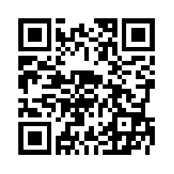
http://padlet.com/mditmore21/wf80vqnfpeiv

Slide 19
http://e.ggtimer.com/

Slide 20
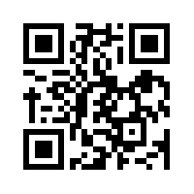
https://kahoot.it

Slide 21
Kicking it Up a Notch What's the Big Deal about Rigor?
Susan Ahmad, Megan Endicott and Myra Wheat
Fulton County Schools

