Slide 1
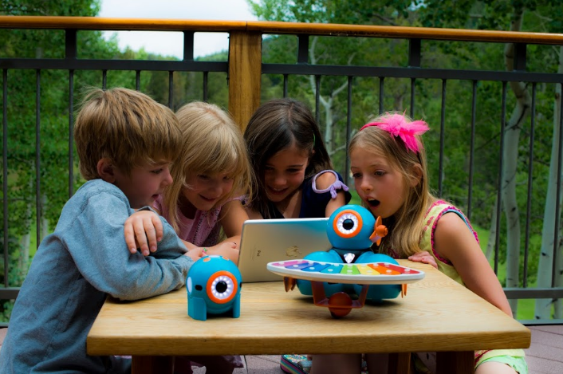
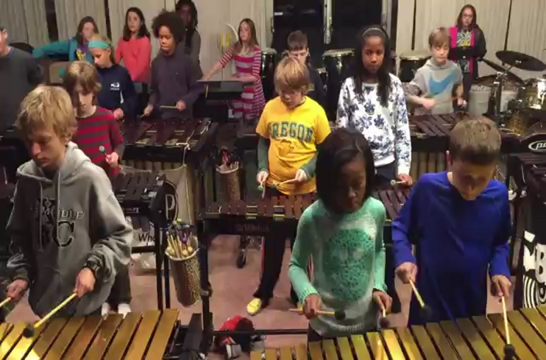
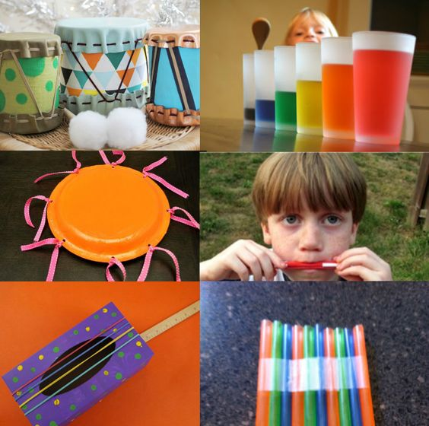
PROJECT BASED LEARNING IN THE MUSIC CLASSROOM
Megan Endicott and Susan Ahmad

Slide 2
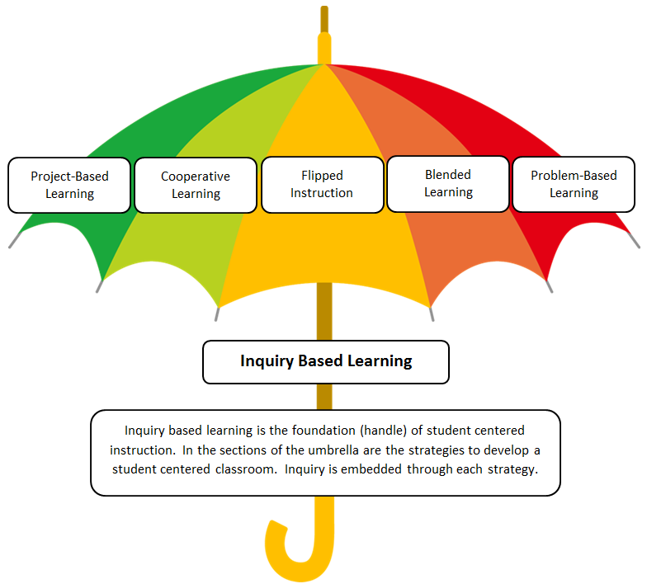

Slide 3
INQUIRY BASED LEARNING
Student-centered
Explores real-world questions and issues
Emphasizes communication, creativity, collaboration and critical thinking
Authentic and intrinsically motivated
Based on a rotating process
Rooted in constructivism

Slide 4
WHAT INQUIRY IS NOT…
Students know what result they are supposed to get
The questions and steps are predetermined for them
The teacher is working harder than the students

Slide 5
Why Inquiry Based Learning?

Slide 6
Addressing the
Start small with something you already do successfully!
Make it authentically aligned to your content standards!
Take a standard and frame it with inquiry – driving questions!
Notes:
Keep it simple
The more you add to the DQ the more teacher driven it becomes

Slide 7
Step One – What Does the Teacher Control?

Slide 8
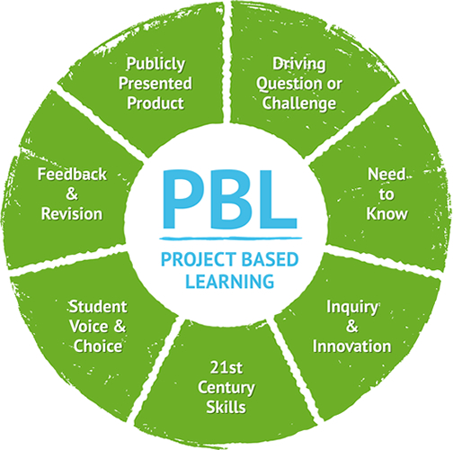
Teacher
Teacher

Slide 9
How do I plan a PBL activity?
Develop Driving Questions and Project Description
List Objectives
Create an Introduction
Notes:
Entry Event is the same as introduction…lead them to want more Real Life Situations
Personally Meaningful
Engaging
Bring the Outside World Into Your Classroom
(Skype, Guest, Video)

Slide 10
FOCUS HABITS
THE TEACHER FACILITATING IN A WAY TO KEEP THE STUDENTS ON TRACK AND FOCUSED
OFFER MULTIPLE PERSPECTIVES
ANSWER ALL THEIR QUESTIONS WITH ANOTHER QUESTION
PROMOTE DIVERGENT THINKING
KEEP STUDENTS FOCUSED ON THE STANDARD

Slide 11
Step Two – Creating a Driving Question

Slide 12
Developing Inquiry Based Questions
Question
How can…
How do…
Should…
Could…
Who?
I/We
Students
Teachers
Community
Organizations
City/State
Politicians
Action
Build
Create
Make
Design
Plan
Write
Purpose
Decide
Produce
For
A Classroom
A School
An Audience
A Community
A Global Audience

Slide 13
Write a driving question…
Students make choices that determine the outcome
Based in real-world experiences or problems
Emphasizes communication, creativity, collaboration, and critical thinking.
Uses multiple resources

Slide 14
Step Three – Evaluate Your Plan

Slide 15
THE
www.kahoot.it
Projects vs. Project-Based Learning

Slide 16
Projects | Project-Based Learning
Can be done alone | Requires collaboration and teacher guidance
About the product | About the process
Is teacher-directed | Is student-directed
All projects have the same goal | Students make choices that determine the outcome
Products are submitted to the teacher | Products are presented to an authentic audience
Lack real-world relevance | Based in real-world experiences or problems
Occur after the “real” learning | Real learning occurs through the project
Notes:
More emphasis on the process instead of the end product

Slide 17
Liz Crane
Creek View ES
How can we create a music video to raise awareness about endangered animals?
4th grade students will write a rap and create a music video public service announcement about how to save endangered species.
Notes:
Project – Where is it going?...website to host video, morning announcements, school website...not much choice….could they choose the performance medium?

Slide 18
Jessica Weingart
Roswell North ES
How can we create a concert to show our community we are thankful?
Students are creating programming for an upcoming concert. They are leaning towards dedicating the program to teachers right now and they’ve come up with some interesting song choices.
Notes:
PBL

Slide 19
Patrick McAvoy
Dunwoody Springs ES
How can music be used to enhance art?
The students listened to “Canten Cantores” and created artwork in a style that matched the song.
Notes:
Project – Isn’t student driven……if the students selected their own music and created their own artwork it would be more PBL

Slide 20
Susan Ahmad
Lake Windward ES
The Kindergarten students need your help. They want to learn about the four types of voices. How can you teach them?
Outcome: 1st grade students will prepare a lesson and teach the Kindergarten students.
Notes:
PBL

Slide 22
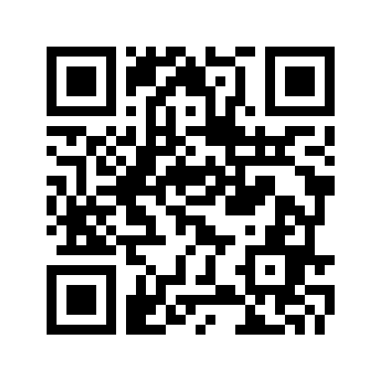
Share Session
http://tinyurl.com/MusicPBLPadlet

Slide 23
Step Four – Assessing Your Students

Slide 24
Types of Formative Assessments
Check-in
Journal or Learning Log
Quick Assessments
Conferencing
Drafts
Check Lists
Prototypes
***Give Several Grades So Everyone is Successful***

Slide 25
Types of Summative Assessments
Did you answer/address the driving question?
Rubrics
Test
Check List
Performance/Product

Slide 26
Reflection during the process
Class discussion
Focus groups
Peer evaluation
Self evaluation
Journal
Survey

Slide 27
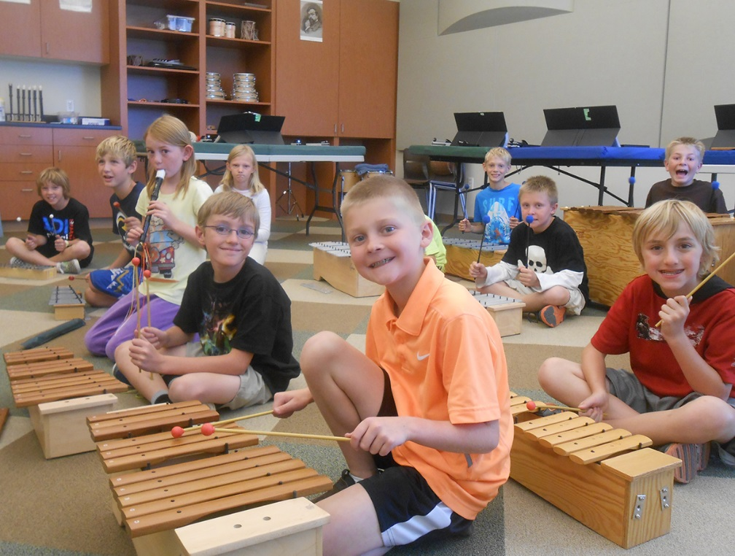
Step Five – Presentations

Slide 28
Presenting
How can students demonstrate what they have learned?
Service project – action
Presentation
Product – publication, composition
Performance

Slide 29
What audience will you have?
Present to another class
PBL Showcase (Community)
Share with global community
Skype
Twitter
YouTube
Websites (Teacher, School, District, State, National)
Publish to business, blogs, Ed magazines
Submit project (somewhere)
Share / Lead convention workshops

Slide 30
Don’t forget to identify an audience
throughout the process. The audience can
even change depending on the direction
the students take with the project.

Slide 31
Step Six – Debrief

Slide 32
Reflect
Debrief as a classroom community
Examine students’ questions vs. the driving question
Allow for self-reflection and evaluation
Identify areas for growth
Reteach/reinforce any concepts that may be lacking
What happens next?

Slide 33
PBL Ideas for the Music Classroom!

Slide 34
PBL in General Music
Solve a Problem:
Someone stole all the instruments in the music room. How will we fill the room with music? (Leslie Morgan)
The ASO has the flu and we have to perform their place…what are going to do? (Megan Endicott)

Slide 35
PBL in General Music
Educational:
Create a campaign for continuing music education after elementary school. (Ariel Robins)
Help…Music teachers across the country need more resources that engage students in the music classroom. (Megan Endicott)

Slide 36
PBL in General Music
Convince Others/Opinion:
Create a public service announcement that persuades the community to be appropriate audience participants. (Susan and Megan)
How can you convince your classmates that they should like your favorite style/genre of music? (Susan and Megan)
Write new lyrics for My Country ‘tis of Thee” to influence change of something you feel strongly about. (Susan Ahmad) *

Slide 37
PBL in General Music
Broad Theme:
How is major and minor depicted in movies? (Susan and Megan)
What would our jazz music be like today had we not experienced the Harlem Renaissance? (Claudia Tschupp)
How did music/lyrics influence people during the civil rights movement? (Liz Crane)

Slide 38
PBL in General Music
Divergent:
What if musical instruments were never invented? (Susan and Megan)
What if Quaver only wrote slow and sad songs? (Susan & Megan ☺)

Slide 39
PBL in General Music
Scenario-Based:
You have been hired to create a new music app. What are the top ten most important things to include and why? (Susan and Megan)
You want to start a band. What steps will you need to take? Come up with a plan to promote your group. (Susan and Megan)
Apple needs help creating new ringtones for their products. Can you help them? (Patrick McAvoy)

Slide 40
Special Thanks to our Sponsor
You can register for the online class at
educationcloset.com
Free Resources
https://educationcloset.com/pbl/

Slide 41
Tony Vincent’s “Learning in Hand”
learninginhand.com/pbl
Fulton County Music Teachers
Dr. David Vandewalker – Fulton County Music Coordinator
Cari Begin – PBL Consultant
Megan Gibson – Hostess and Power Point

Slide 42
PROJECT BASED LEARNING IN THE MUSIC CLASSROOM
Megan Endicott and Susan Ahmad

