Slide 1
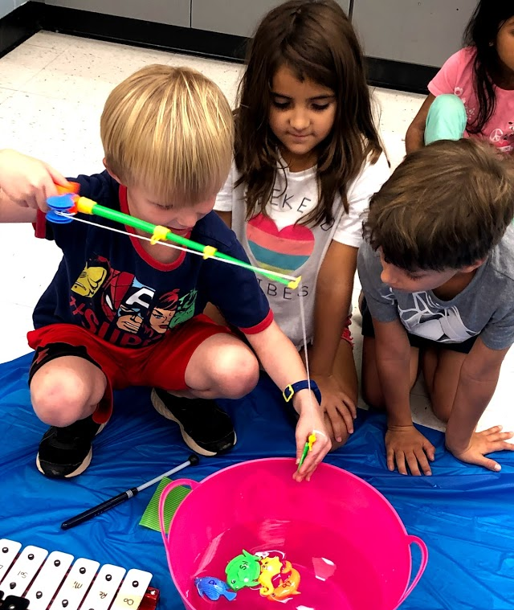
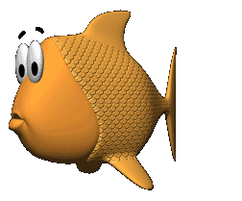
Want to Catch More Fish? Use Better Bait!
Instructional Strategies that “Hook” Students on Learning!
Please Register…
We will use your registration information to
award prizes!!!
Notes:
Add QR code for sign-in

Slide 2
Notes:
(singing Charlie Over the Ocean)
Megan: Hey Susan! I was really looking forward to a good day of fishing!
Susan: Me too, Megan. But I just don’t understand, why the fish aren’t biting?
Megan: Maybe we just need some new strategies!
Susan: Ah! You know, that reminds me of teaching!
Megan: Yes, you are so right. I feel a little the same in my classroom where the kids just aren’t biting.
Susan: Well, while you help me figure out new strategies on fishing, I can help you with instructional strategies for engaging your students in the classroom!
Megan: When you say instructional strategies, what do you mean? Oh like…. And open discussion from PPT

Slide 3
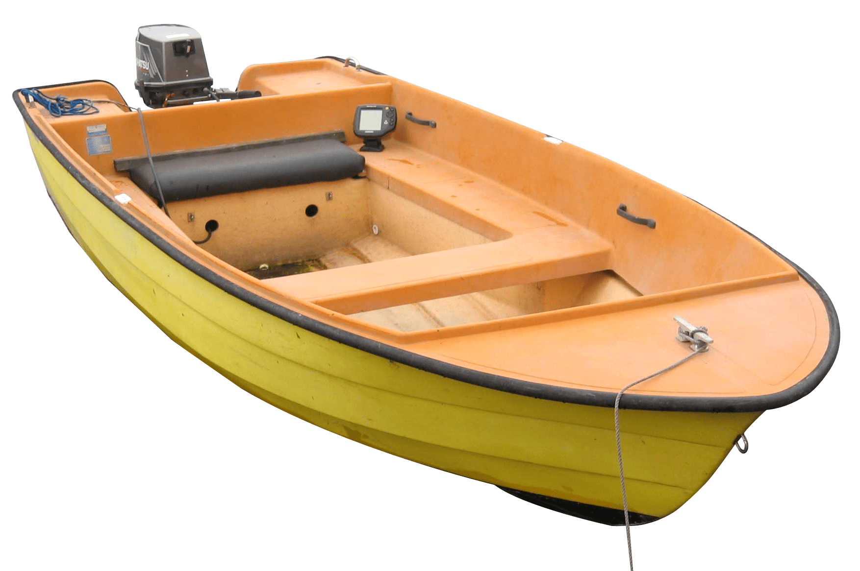
What are instructional strategies?
Instructional strategies are techniques teachers use to help students become independent, strategic learners.
Instructional strategies can:
• motivate students and help them focus attention
• organize information for understanding and memory
• monitor and assess learning
Notes:
Megan….
Make sure to pay attention! We will have a game for PRIZES at the end of this session and if you stay until the end we will be drawing names for Teacher Pay Teacher prizes!
It is important to focus on the planning to include learning stations problem solving, active reading ,alternative assignments, and cooperative learning. This involves thoughtful planning so each activity is focused on the learning target and motives students to better understand the key focus, organize information for understanding and memory by unlocking prior knowledge and extending the learning. And finally includes a thoughtful process for consistently assessing and monitoring the learning.

Slide 4
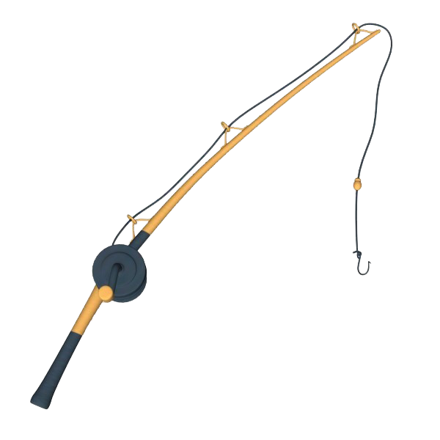
To become successful strategic learners, students need:
• Step-by-step strategic instruction
• A variety of instructional approaches
and learning materials
• Appropriate support that includes modelling,
guided practice and independent practice
Notes:
Susan…..
Let’s take a look at what students need to become successful learners
• Step-by-step strategic instruction
Small steps that the students can complete independently or in small groups
• A variety of instructional approaches
and learning materials
Choices that the students can make between the process or the materials they use
• Appropriate support that includes modeling,
guided practice and independent practice
Modelling the process before the students begin, they practice as a group, then they practice independently

Slide 5
To become successful strategic learners, students need:
• Opportunities to transfer skills and ideas
from one situation to another
• Meaningful connections between skills
and ideas, and real-life situations
Notes:
Susan…
• Opportunities to transfer skills and ideas
from one situation to another
Give the students several different ways to complete the same task. Ask the students for additional ideas….they are very creative and often suggest things you haven’t thought of!
• Meaningful connections between skills and ideas,
and real-life situations
How can your lesson relate to other units, other cultures, and things in our society

Slide 6
To become successful strategic learners, students need:
• Opportunities to be independent
and show what they know
• Encouragement to self-monitor and self-correct
• Tools for reflecting on and assessing own learning
Notes:
Susan…
• Opportunities to be independent
and show what they know
Allow them to be creative. Advanced students should have the opportunity to customize their work and share what they know with the class
• Encouragement to self-monitor and self-correct
Offer several different ways for students to reflect and assess their progress and to help others
• Tools for reflecting on and assessing own learning
Make sure there is something measurable in your lesson

Slide 7
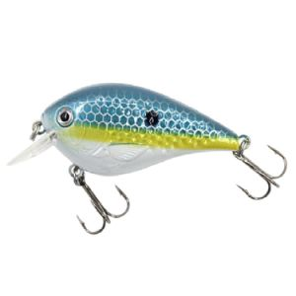
What do Instructional Strategies look like in the music classroom?
Active Reading
Problem Solving
Learning Stations
Multiple Intelligences
Alternative Assignments
Cooperative Learning
Concepts Maps and Webbing
Notes:
Megan…

Slide 8
Instructional Strategies
Multiple Intelligences:
Linguistic:
ability to use language to express
2. Logical/Mathematical:
ability to manipulate things
Notes:
Megan…
Finding ways to plan strategies to reach each learner is important. One way to adjust instruction is to plan ways to teach with multiple intelligences in mind. For example:
(Verbal)Linguistic: Ex: connections with Kodaly and “how the words go” help students understand rhythms. This can be useful when breaking down ostinatos. To reach these learners, you would also be mindful to include some whole group / class meeting time.
Logical / Mathematical: Ex. Understanding of time, meter, and rhythm and how to manipulate these to fit into the musical structure. These learners would rather investigate to find the answer. They are focused on objective rather than subjective problems.

Slide 9
Instructional Strategies
Multiple Intelligences:
3. Musical Rhythmic:
hear and remember patterns
4. Bodily/Kinesthetic:
ability to move all parts of body to solve a problem or make something
Notes:
Megan…
Musical Rhythmic: Ex. Utilizing patterns in music to understand form or rhythm patterns. Strategies could focus on imitation. (We do this often with echo patterns and phrases) Teaching some things by rote could be helpful for musical learners. In addition, composition opportunities.
Bodily / Kinesthetic: Ex. Placing pitch syllables on the body to represent high / low can be useful when identifying how the melody is moving and more easily transferred to voice and instruments. In addition, adding in creative movement opportunities, lessons that involve acting or performing, and building and seeing how things work.

Slide 10
Instructional Strategies
Multiple Intelligences:
5. Spatial:
ability to represent the spatial world internally in your mind
6. Naturalist:
sensitive to the features of the natural world
Notes:
Megan…
(Visual)Spatial: Ex. When we identify steps, skips, and repeats, as well as melodic direction. These learners learn best with graphs, charts, diagrams, and colorful displays.
Naturalist: Ex. The ability to make connections from things in our world and music through soundscapes. These learners are engaged by nature.

Slide 11
Instructional Strategies
Multiple Intelligences:
7. Intrapersonal:
understanding of self
8. Interpersonal:
understanding others
9. Existential:
questions everything
Notes:
Megan…
Intrapersonal: Ex. Often introverted and internalist. Find ways to offer quiet work time (without collaboration) or journaling / reflective practices to ensure comfort and strength from these learners.
Interpersonal: Ex. These learners are social and thrive off of collaboration. Building in collaborative projects / discussions / activities is key for these learners.
Existential: Ex. The relationships built between the musician and their listener. These students think more philosophically. For these students it is important to make connections to what is being learned and the outside world. (relevance) Discuss the big picture, summarize at the end of class, look at the topic from different points of view.

Slide 12
Instructional Strategies
Learning Stations:
Rotating, Individualized, Sequential, Thematic, Enrichment
Notes:
Susan…
Learning Stations are another Instructional Strategy
They can be rotating, individualized, sequential, thematic, and enriching

Slide 13
Instructional Strategies
Learning Stations:
Rotating
All students complete same stations, however each station has varying levels of difficulty that students can decide between.
Notes:
Susan…
Rotating…All students complete same stations, however each station has varying levels of difficulty that students can decide between.
For example…center 1 is the Brass family…and the students can choose between drawing a picture of the instruments in the Brass family and labeling them, writing about how Brass instruments are different from each other, or comparing and contrasting the Brass family with the Woodwind family.

Slide 14
Instructional Strategies
Learning Stations:
Individualized
Students are assigned the level that they will complete at each station, based on pre-assessment.
Notes:
Susan…
Individualized
Students are assigned the level that they will complete at each station, based on pre-assessment.
The students are giving a diagnostic assessment and are assigned a team…1,2,3 or Red, Blue, Green. Each center has three levels of activities…below level, on-level, and enrichment

Slide 15
Instructional Strategies
Learning Stations:
Sequential
Stations start students with lower level activities and students can move to more advanced activities once they have completed each step.
Notes:
Susan…
Sequential
Stations start students with lower level activities and students can move to more advanced activities once they have completed each step.
Students complete as many leveled activities in the amount of time given

Slide 16
Instructional Strategies
Learning Stations:
Enrichment
Students who are able to complete lesson activities before the majority of the class, can work on enrichment stations.
Notes:
Susan…
Enrichment
Students who are able to complete lesson activities before the majority of the class, can work on enrichment stations.
It is a great idea to have a few stations for each unit that can be completed by students who finish early, or who need something more challenging.

Slide 17
Instructional Strategies
Problem Solving:
Define the problem, Analyze the problem, Establish criteria, Propose solutions, Take action
Reflective Discussion:
The questions should be open-ended
Web Quest:
Introduction, Task, Resource, Process, Evaluation, Conclusion
Notes:
Megan…
Problem Solving:
Define the problem, Analyze the problem, Establish criteria, Propose solutions, Take action
Reflective Discussion: The questions should an open-ended question
Web Quest: Introduction, Task, Resource, Process, Evaluation, Conclusion

Slide 18
Instructional Strategies
Active Reading:
Asking questions, making predictions, asking open and closed questions, comparing and contrasting information
Notes:
Megan…
Active Reading
Asking questions, making predictions, asking open and closed questions, comparing and contrasting information

Slide 19
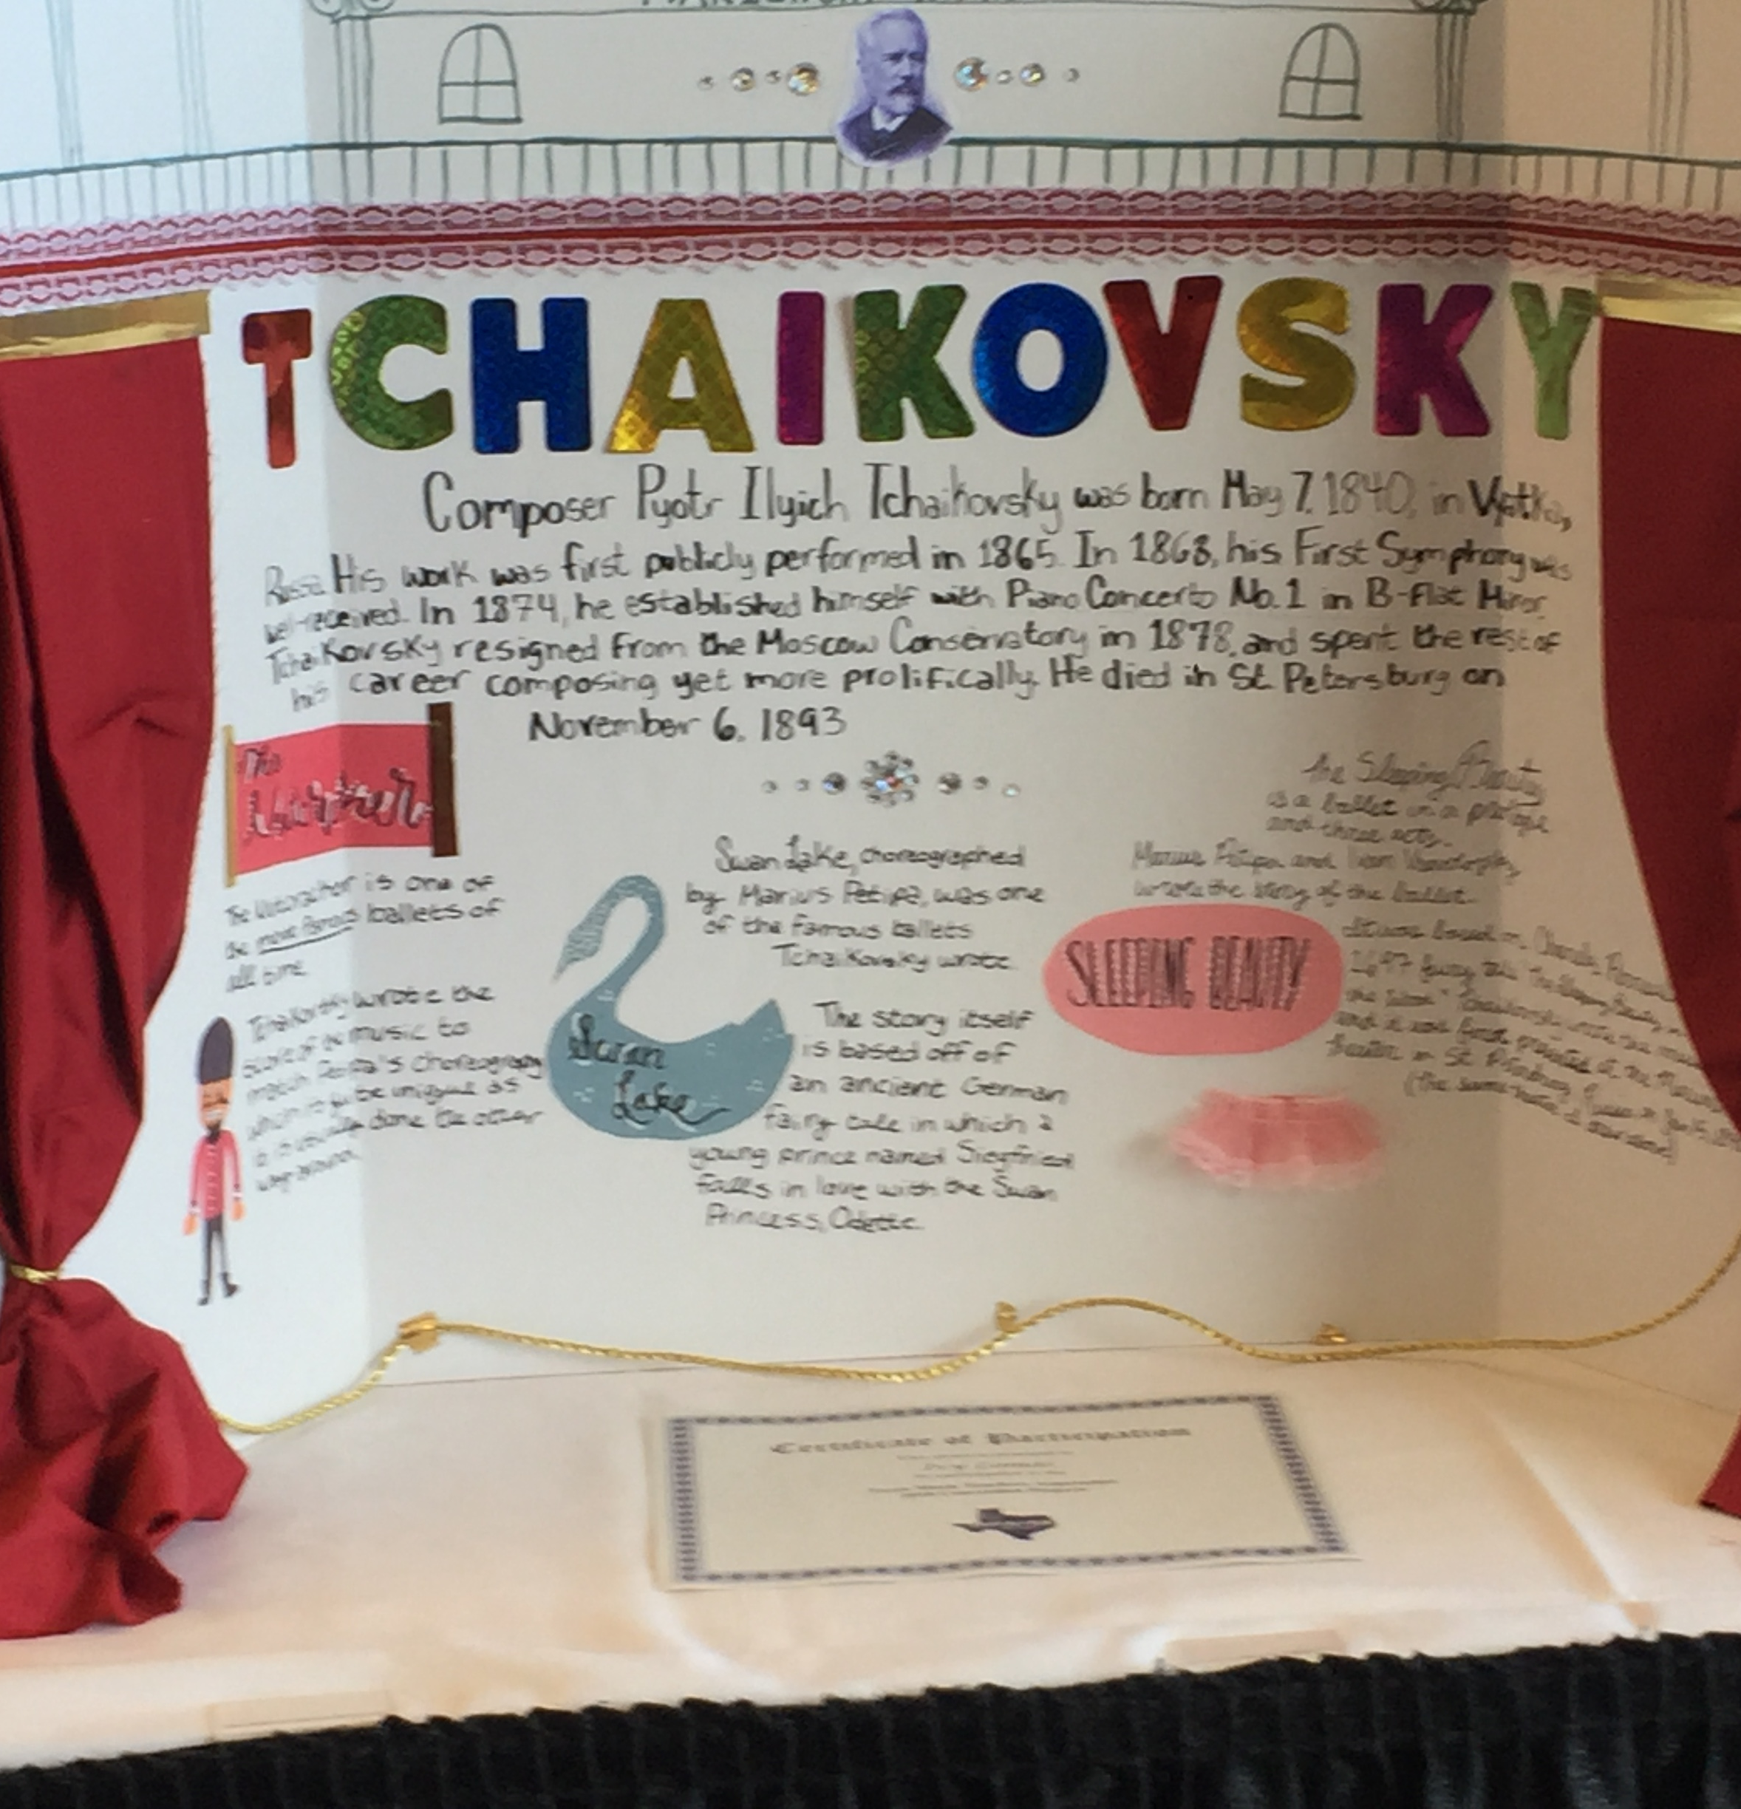
Instructional Strategies
Alternative Assignments:
Advanced: Project, composition, debate, digital presentation
Supplemental: Flash cards, concise/simplified directions (have student repeat the directions), content review, graphic organizers
Notes:
Susan…
Several of your students will need alternative assignments.
Your Advanced Students can work on a Project, a composition, prepare for a debate, or even create a digital presentation.
Some students will need supplemental activities: Flash cards, simplified directions…you should have the student repeat the directions, content review, and graphic organizers

Slide 20
Instructional Strategies
Concept Maps and Webbing:
Connecting skills, structures, and strategies to the main concept
Notes:
Megan…
Concept Maps and Webbing:
Connecting skills, structures, and strategies to the main concept
This is especially important when the content or material is vast in nature. I found this helpful with my upper grades when discussing expression vocabulary. Students were able to make a concept map to display differences and similarities (show picture)

Slide 21
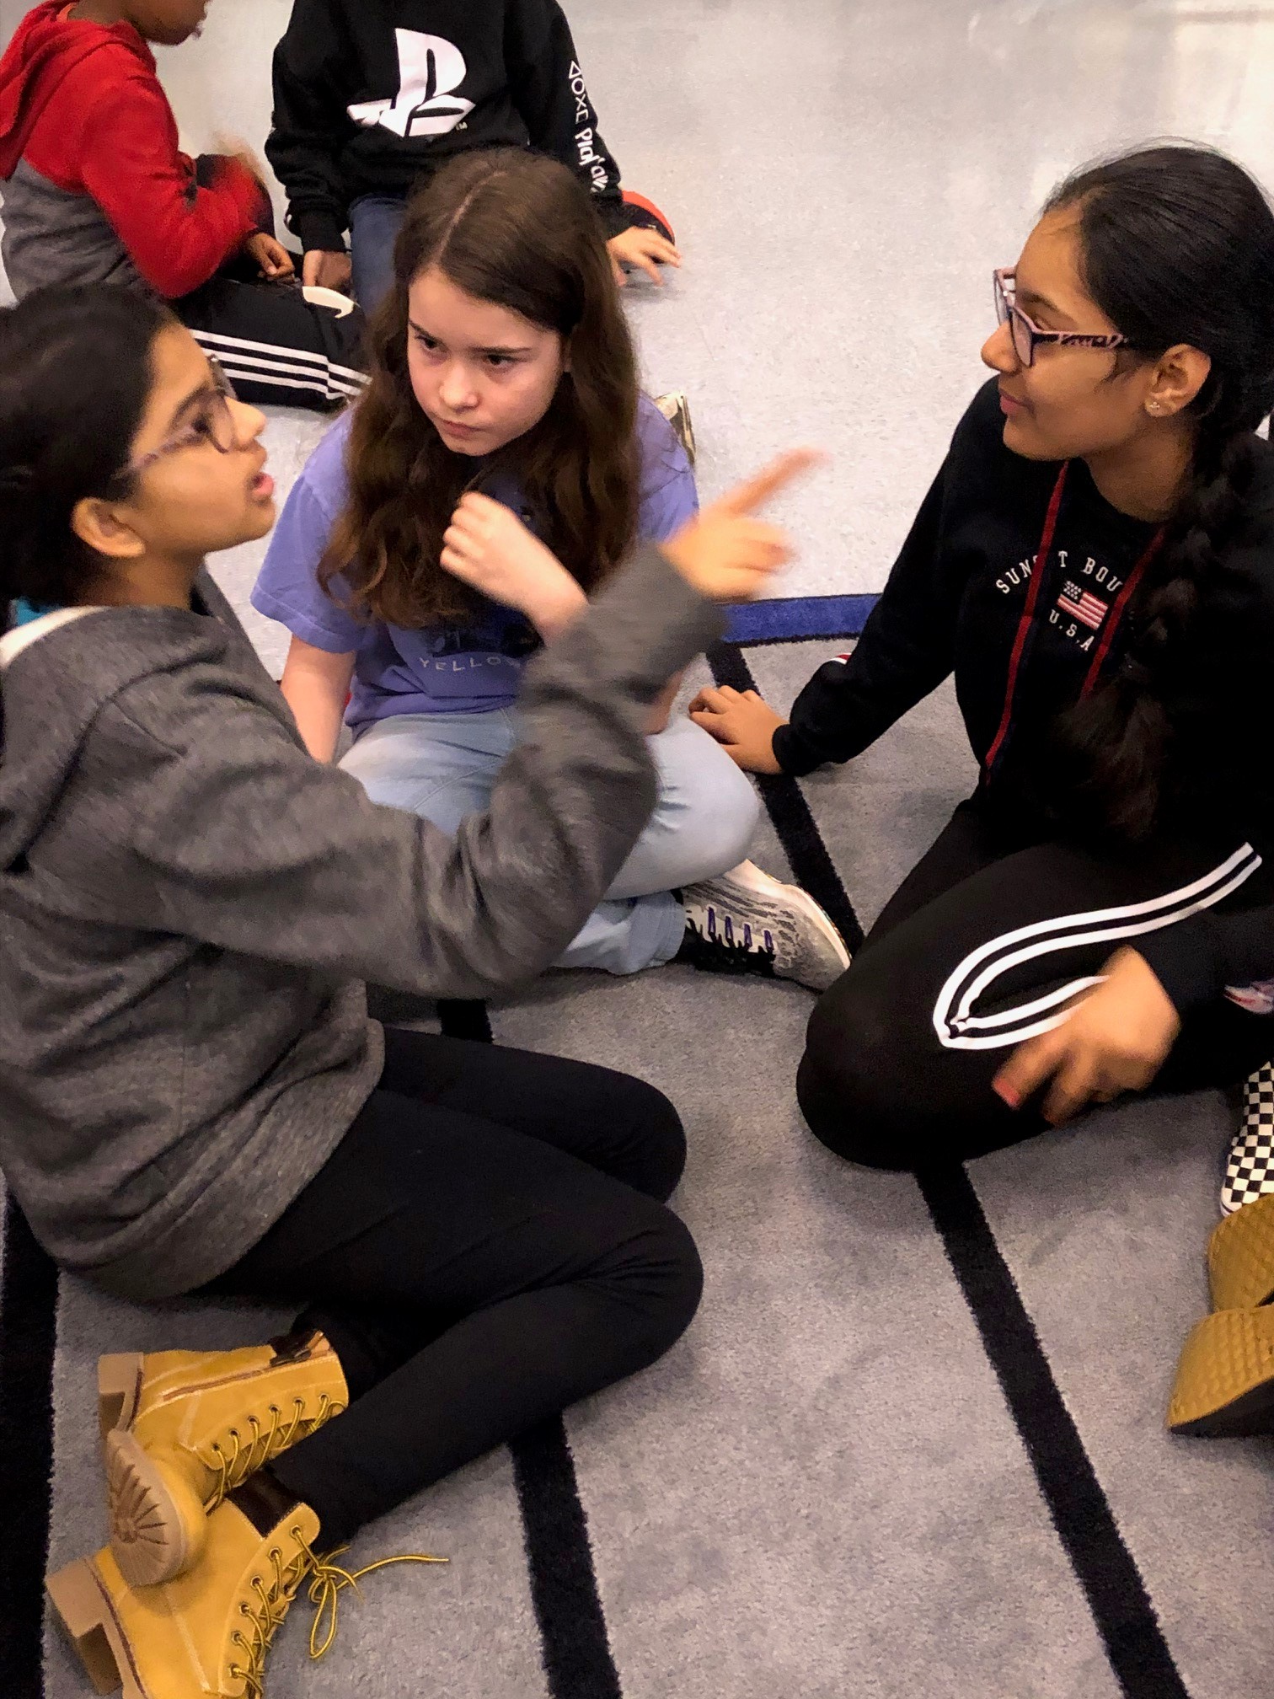
Instructional Strategies
Cooperative Learning:
Jigsaw: Each member of the team works independently and then teaches what they have learned to their group.
Think-Pair-Share: Think of answer, compare thoughts with a neighbor, share with others.
Notes:
Megan…
Cooperative Learning:
Jigsaw
Think-Pair-Share

Slide 22
Instructional Strategies
Cooperative Learning:
Numbered Heads Together: Team of four (each student is numbers 1,2,3,4). The team decides on answer to question, one number is called and that student answers for the group.
Structured Problem Solving: Groups are given a problem to solve within a specified amount of time. All members must agree on the solution and be able to explain the solution.
Notes:
Megan…
Cooperative Learning:
Numbered Heads Together
Structured Problem Solving

Slide 23
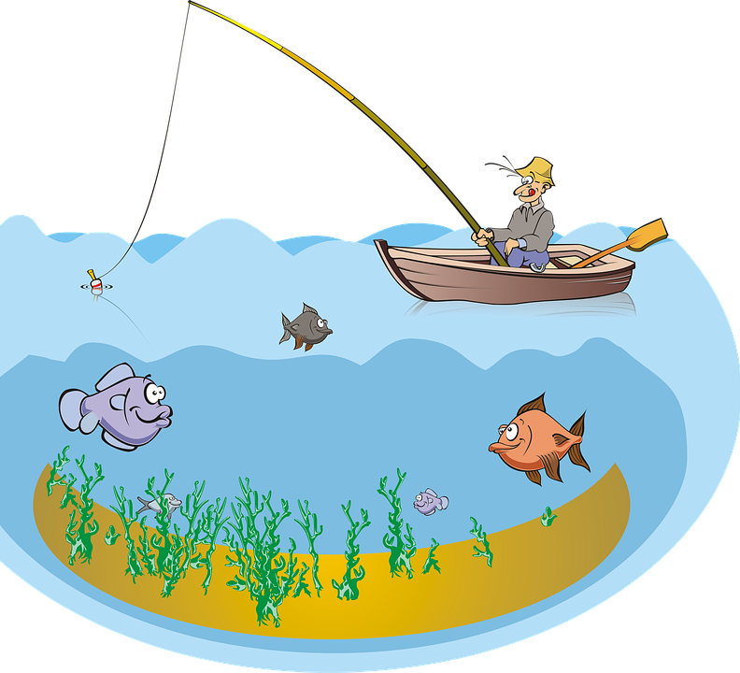
Rules:
Groups of no more than 10 at each pond.
Don’t open the envelope until the music starts.
There are instructional strategies in each envelope. Your whole team must work on ONE at a time as a team.
Sort the cards into the different categories of instructional strategies.
No technology can be used to assist your decisions.
When the song is over, all remaining cards must be put back in your envelope.
Notes:
Susan….
Now it is time to play a review game…..These are the rules:
Groups of no more than 10 at each pond.
Don’t open the envelope until the music starts.
There are instructional strategies in each envelope.
Your whole team must work on ONE at a time as a team.
Sort the cards into the different categories of instructional strategies.
No technology can be used to assist your decisions.
When the music ends, all remaining cards must be put back in your envelope.

Slide 24
READY SET GO!

Slide 25
How to “hook” your students…
Dress up
Video
Q&A
Mystery Item
Guess what we are studying
Theme
The hook
Notes:
Susan…
How do teacher Hook students?
Dress up….like a famous musician
Use a Video clip to introduce the topic
Q&A….ask questions to students to get them thinking about what they will be learning
Mystery Item…like a trumpet for a brass lesson….or a leaf for a fall melodic direction lesson
The students could Guess what we are studying based on a picture or group of words
Select a Theme for the lesson or a whole unit

Slide 26
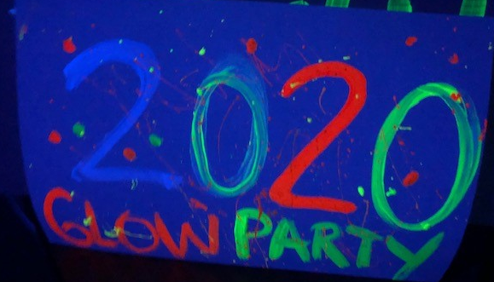
Notes:
Susan….
A great theme is a Glow Party…..you can use glow sticks to match the melodic direction of a song and use glow in the dark sand to create rhythm patterns. You can also use light-up wands and toys for movement activities.

Slide 27
Notes:
Here is a video of a way Megan has “hooked” her students!

Slide 28
The Line
Map out where you are going
Planning
Transition from Hook to lesson
Pair and Share
Driving Questions
Community
Movable bulletin board: concepts, move to front,
grab from wall, read for me, solve the problem
Notes:
Megan….padlet
Now that you have various ideas for reaching all types of learners, and a good hook to get the students engaged, it’s time to create your plan!
Your plan should be expansive and include a variety of activities throughout the lesson as well as the unit.
The “line” could be….

Slide 29
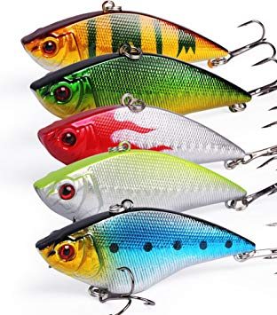
State Learning Target:
Entire lesson tied into target
Consider Learning Styles
Include Modalities: Sing, Move,
Play Instruments
Group Students for Personalized Learning:
Whole group intro…small groups
Small as the intro….large group
Groups can be based on prior knowledge, interests, and skills.
The bait
Notes:
Susan….How do we Bait our students?
State the Learning Target: Entire lesson tied into target…if rhythm is your target then every activity you do in your lesson should be focused on rhythm
Consider Learning Styles….Visual, tactile, auditory
Include Modalities: Sing, Move, Play, Instruments…at some point in every unit you should be including all 4 of these modalities
Group Students for Personalized Learning:
Whole group intro…small groups
Small as the intro….large group Groups can be based on prior knowledge, interests, and skills.

Slide 30
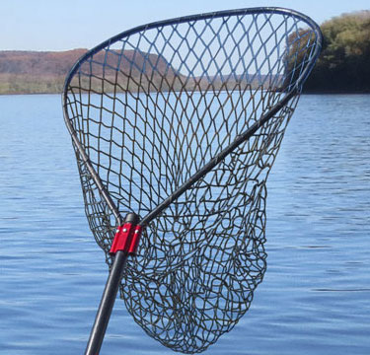
The net
Tie it all up
Class discussion
Reflection
Pair and Share
What did you learn?
Questions to figure out what is coming next
Notes:
Megan…pair and share

Slide 31
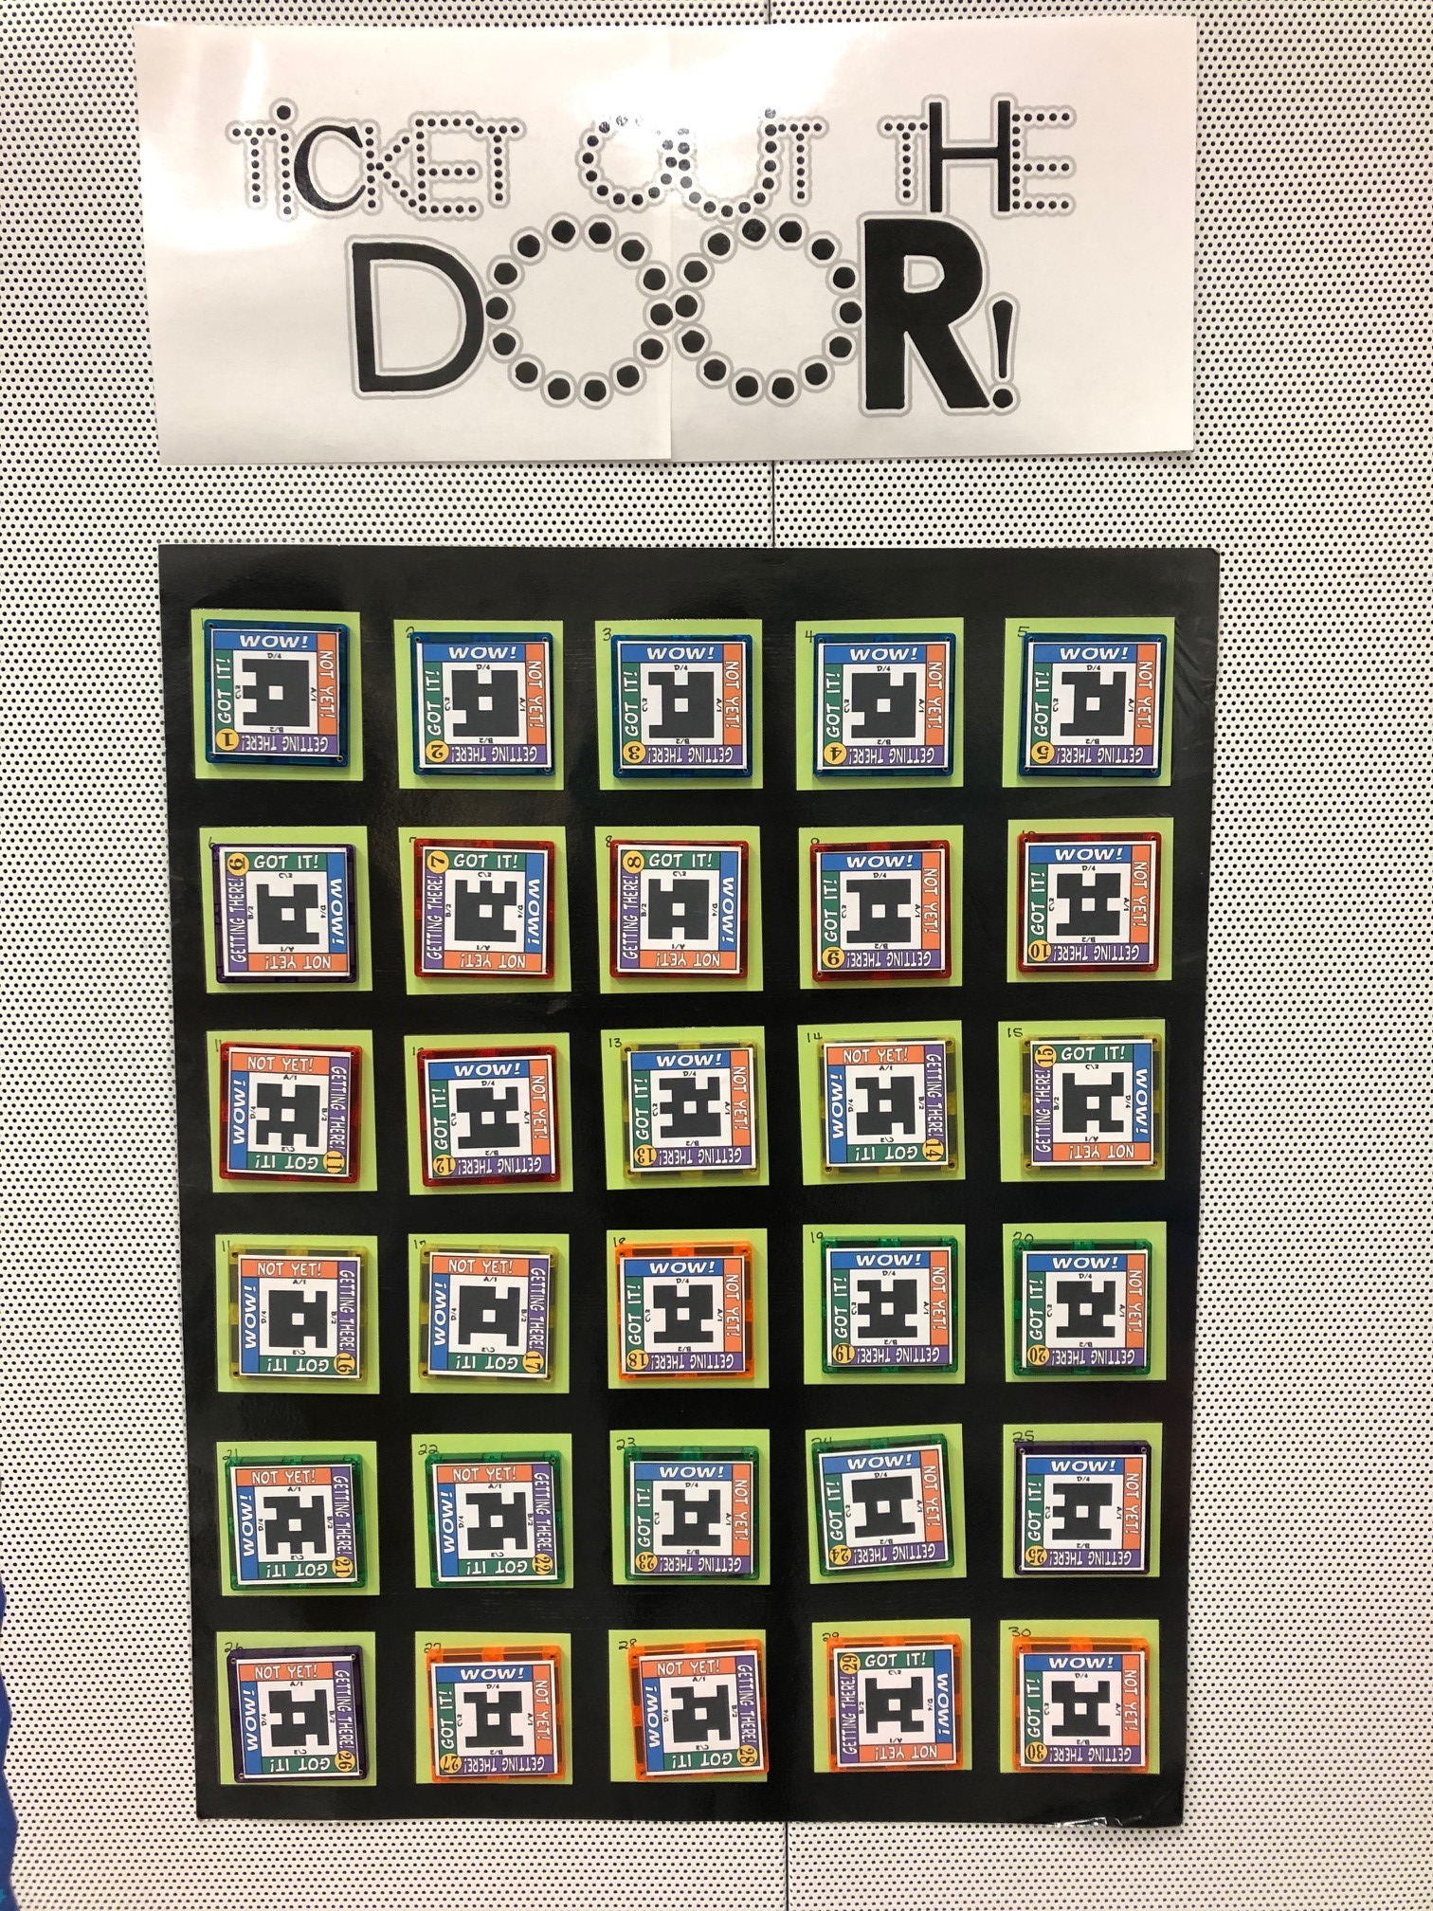
Notes:
Megan

Slide 32
Diagnostic (before you teach):
Written Assessments
Plickers
High 5
Clapping rhythm or reading Solfege patterns and asking students which
one they heard
The sinker
Notes:
Susan….
There are so many ways to assess your students.
The Diagnostic assessment should be completed before you teach:
Some ideas include….
Written Assessments
Plickers
High 5
Clapping rhythm or reading Solfege pattern and asking students which one they heard

Slide 33
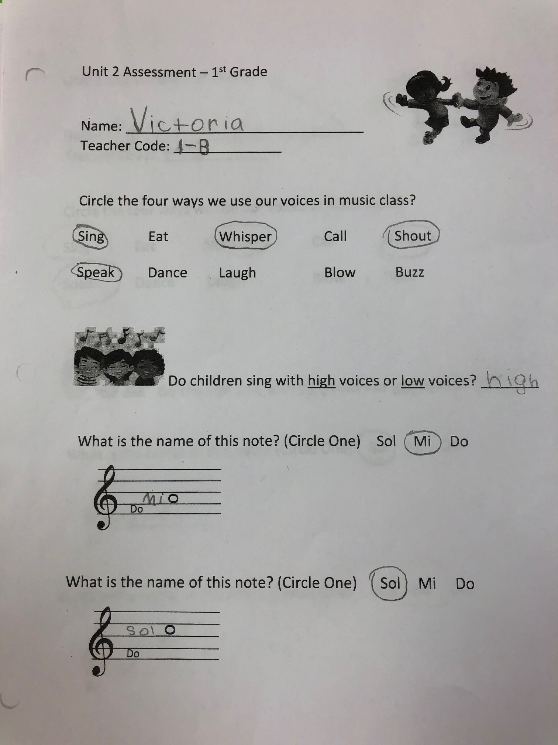
Diagnostic: Written Assessment
The sinker
Notes:
Susan….
The Written Diagnostic Assessment can be per unit or topic and can be given again as a summative assessment to show growth and understanding.

Slide 34
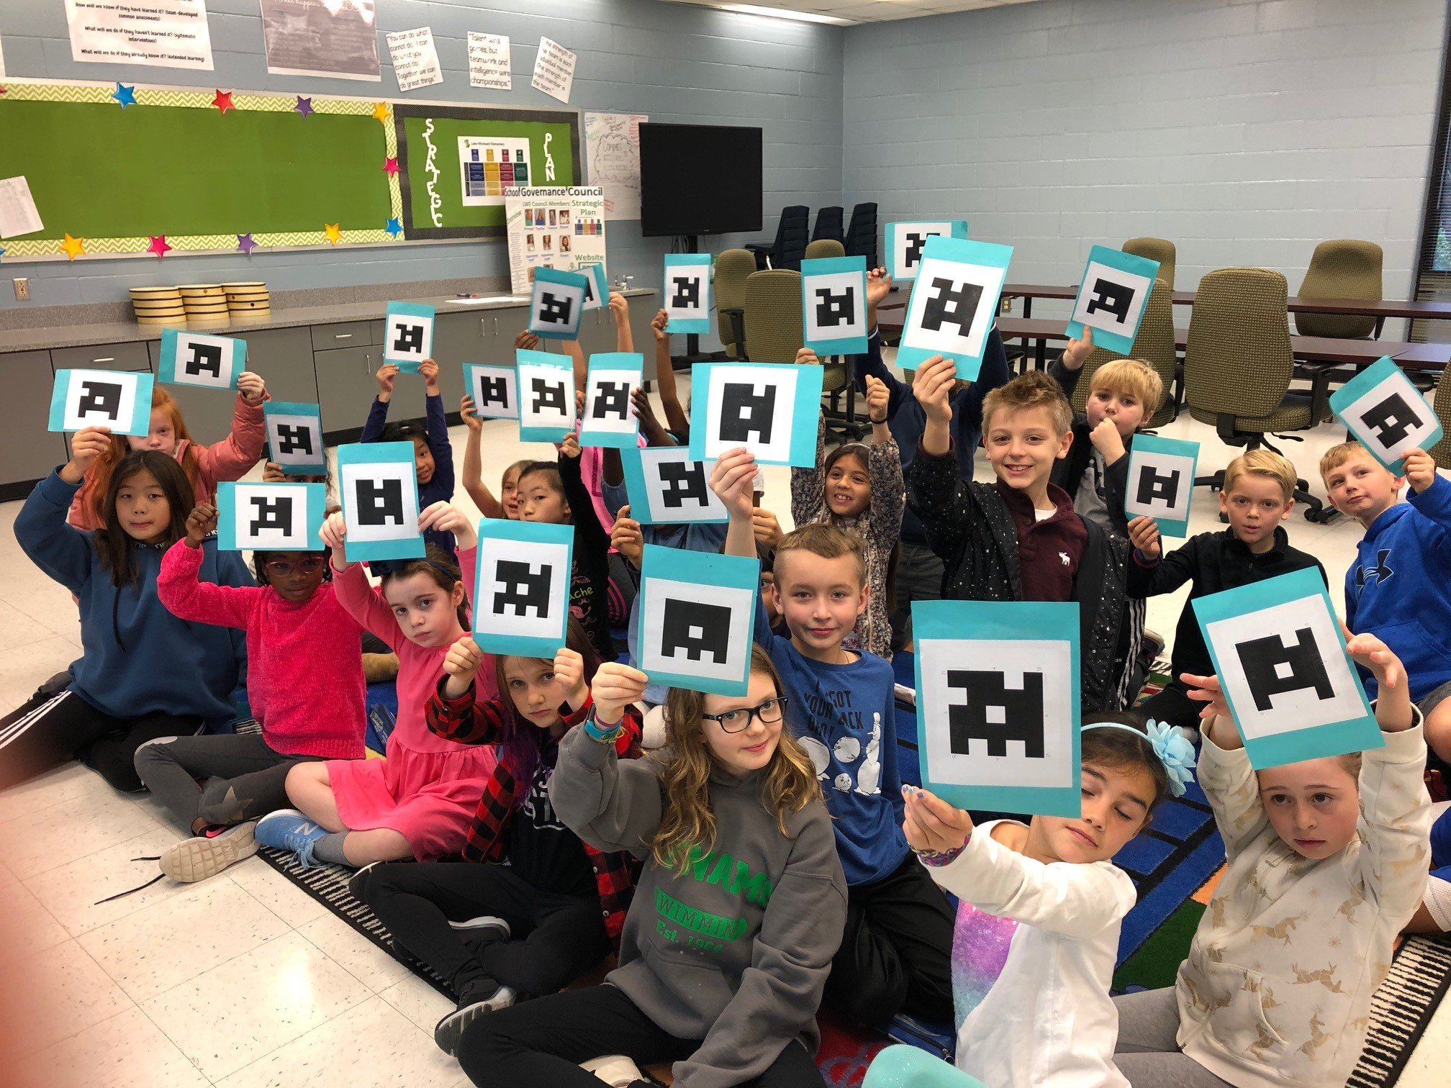
Diagnostic: Plickers
The sinker
Notes:
Susan….
Plickers is also a great diagnostic assessment…you can load 5 questions per plickers assessment….but you can create two if you want a longer assessment and link the students to both assessments.

Slide 35
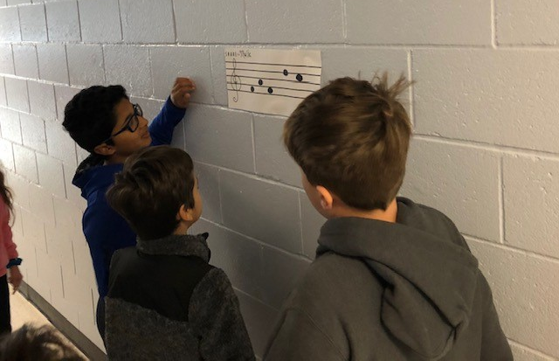
Diagnostic: High 5
The sinker
Notes:
Susan….
High 5 is a fun diagnostic assessment. I Posted a Solfege pattern in the hallway outside my room. The students looked at the pattern and decided what the names of the pitches were.

Slide 36
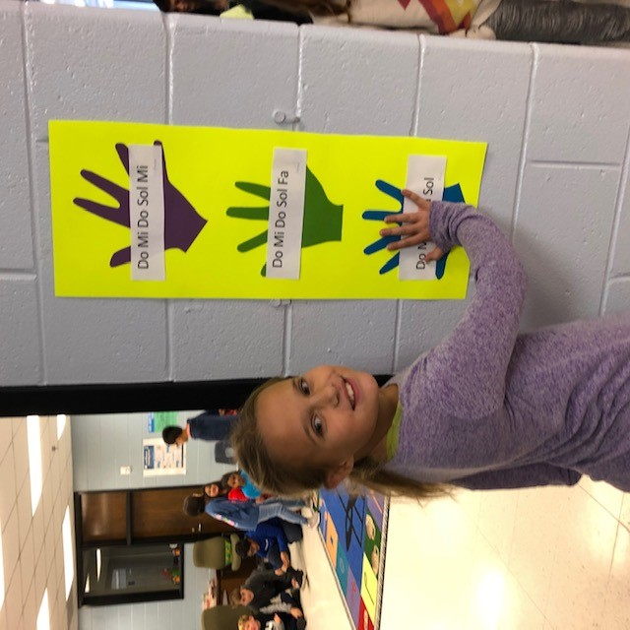
Diagnostic: High 5
The sinker
Notes:
Susan….
The students lined up on the wall and one at a time they came around the corner and put their hand on the hand they thought had the right answer.

Slide 37
Solfege Centers
Purple Team: Read Flashcards with teacher and then with partners.
Green Team: Place chips on your chart to create the Solfege patterns listed on the board.
Blue Team: Compose Solfege patterns on flashcards and write the answers on the back. Use cards to challenge others on your team.
Notes:
Once the students entered the classroom, they went straight to the group that was the color of the hand they selected on the chart. The centers were leveled skills.
The Purple Team was the lower level group: Read Flashcards with teacher and then with partners.
The Green Team was the on-level group: Place chips on your chart to create the Solfege patterns listed on the board.
The Blue Team was the above level group: Compose Solfege patterns on flashcards and write the answers on the back. Use cards to challenge others on your team.

Slide 38
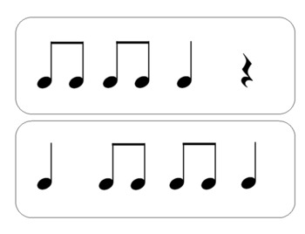
Diagnostic:
Clap rhythm or read Solfege pattern
…which one did you hear?
The sinker
Notes:
Susan….
A diagnostic assessment can also be as simple as holding up two flashcards and clapping a rhythm or singing a Solfege pattern and the students pointing to the correct one and explaining why they selected that card.

Slide 39
The Key is to use the Diagnostic Assessment to group students and to customize your lesson plans!
Notes:
Susan…
Always remember…The Key is to use the Diagnostic Assessment to group students!

Slide 40
Formative (end of day):
Student surveys:
List of things they want to learn next week
Checklists
Thumbs up
Ticket out the Door
What do you need more work on?
The sinker
Notes:
Megan – make sure to denote a quick difference between formative and summative – formative is a short / quick check to guide instruction. Different from a summative more inclusive assessment process.

Slide 41
Summative (end of unit):
Formal assessment
Project
Composition
Rubric
Conferencing with students
The sinker
Notes:
Susan….
Summative assessments are formal and should reflect what a student has learned across several lessons or a unit.
These assessments can be a written assessment, a project, a composition, a rubric for performance skills, or conferencing with individual students.

Slide 42
Notes:
Megan: Well Susan, I don’t know about you, but I certainly feel much better about hooking my students on learning! And I hope you all do too!
Susan: Now, back to these fish that just aren’t biting! What are we going to do!
Megan: Oh, I know, let’s try a different strategy and use a different pool! And maybe some new fishers!

Slide 43
Go Fish
Now it is time for some of you to go fishing for gifts from Teachers Pay Teachers!
Whichever number is “caught” will win! We need 6 volunteers!

Slide 44
Special thanks to David Row, Jennifer Filipiak, Lori Sweet, Kim Maloney, Ginny Capps, Michelle Warshany, and Shelley Tomich
for donating our prizes!
Notes:
We would like to thank David Row and Shelley Tomich for their Teachers Pay Teachers donations! Please support them by looking at all the wonderful products they have to offer.

Slide 45
Take a picture of this slide and save it!
You can find today’s presentation at
www.mrsahmadsmusicnotes.weebly.com
If you have questions, would like help with a lesson, or would like to share your great ideas…please contact us!
Megan Endicott endicott@fultonschools.org #EndicottSpot
Susan Ahmad ahmad@fultonschools.org #LWEMusicNotes

