Slide 2
Why do we need to Spice Things Up?

Slide 3
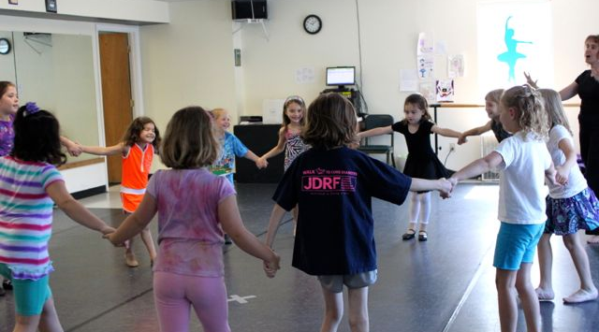

Slide 4
Behavior Issues

Slide 7
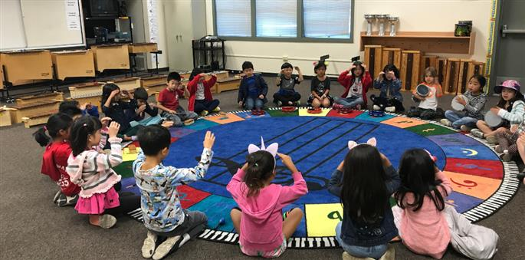
Whole Group Instruction

Slide 8
WHAT IS LEVELED INSTRUCTION?
DIFFERENTIATED INSTRUCTION
PERSONALIZED LEARNING
DIVERSE CLASSROOM
LEVELED CENTERS
VOICE AND CHOICE
PROJECT BASED LEARNING
ADAPTIVE LEARNING
ENRICHMENT AND REMEDIATION

Slide 9
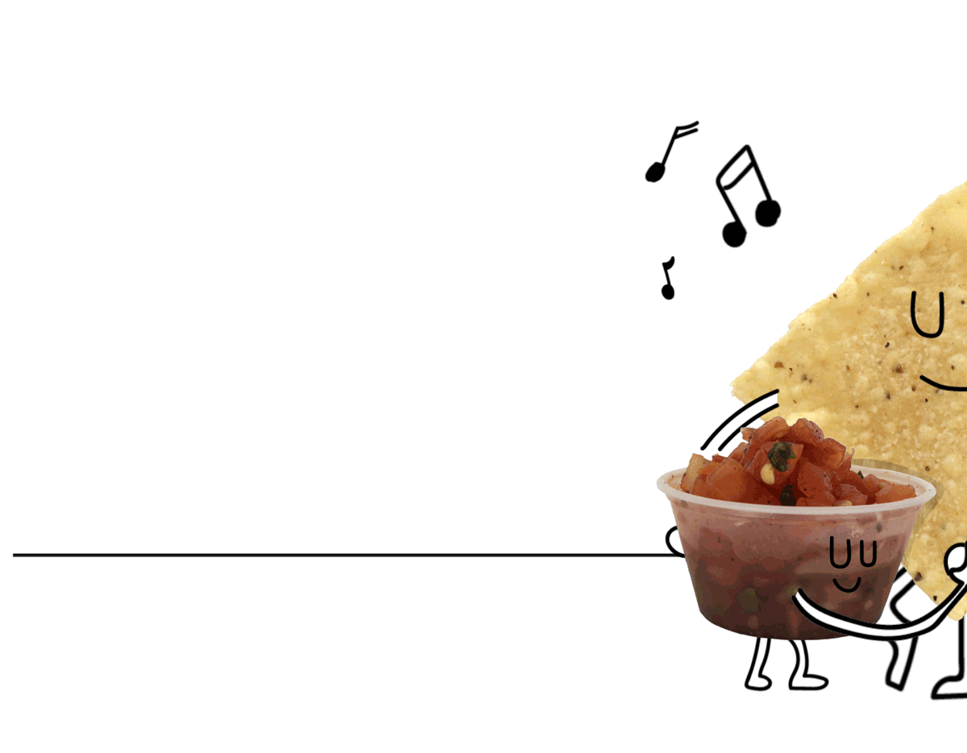
HOW DO WE PLAN FOR LEVELED INSTRUCTION
SELECT UNIT OR LESSON THEME
PULL STANDARDS THAT MATCH YOUR THEME
SORT STANDARDS – NICE TO KNOW (FAMILIAR WITH), IMPORTANT TO KNOW (SUPPORTING STANDARDS), AND NEED TO KNOW (PRIORITIZED STANDARDS)

Slide 10
ASSESSING YOUR STUDENTS
A DIAGNOSTIC ASSESSMENT IS NECESSARY BEFORE YOU BEGIN INSTRUCTION
IT TELLS YOU WHAT YOUR STUDENTS ALREADY KNOW BEFORE YOU BEGIN INSTRUCTION
SOMETIMES, YOUR ENTIRE CLASS DOESN’T HAVE ANY PREVIOUS KNOWLEDGE…ESPECIALLY YOUNGER GRADES
AS THE STUDENTS GET OLDER, YOU WILL HAVE A LARGER GAP IN THEIR PRIOR EXPOSURE

Slide 11
CREATING YOUR ASSESSMENT
DESIGN YOUR ASSESSMENT TO COVER EACH OF THE PRIORITIZED STANDARDS THAT YOU WILL BE TEACHING IN THE UNIT

Slide 12
“SPICE UP” YOUR ASSESSMENT
IS YOUR ASSESSMENT STRONG OR WEAK?

Slide 13
“SPICE UP” YOUR ASSESSMENT
Does your assessment address each standard you will teach?

Slide 14
“SPICE UP” YOUR ASSESSMENT
Are there varied types of questions on your assessment?

Slide 15
“SPICE UP” YOUR ASSESSMENT
Will your assessment give you a good picture of what your students already know and what they need to learn about your new topic?

Slide 16
LEVELED STARTING POINTS 0 1 2 3
LEARNING PROGRESSION
0 STUDENT REFUSED TO COMPLETE ASSESSMENT
1 STUDENT DIDN’T SUCCESSFULLY ANSWER THE QUESTIONS/PERFORM THE TASK
2 STUDENT WAS PARTIALLY SUCCESSFUL
3 STUDENT ANSWERED ALL QUESTIONS SUCCESSFULLY
This tells you very simply what your groups will be. As you teach your unit…your students will be graded based on their growth…not just their knowledge.

Slide 17
GOAL….MOVING YOUR ENTIRE CLASS TO 3.0
0…1 Successful with teacher assistance
1…2 Perform basic processes
2…3 Accomplish unit goals
3…4 Demonstrate in-depth inferences and applications that go beyond what was taught

Slide 19
WHAT DOES LEVELED INSTRUCTION LOOK LIKE TO YOUR ADMINISTRATIVE TEAM WHEN THEY LOOK AT YOUR LESSON PLANS OR OBSERVE YOU TEACHING YOUR MUSIC STUDENTS?
Unit of instruction clearly labeled
Standards included
Data collection assessments and results available
Statement that students will be moved up levels as they master skills
Leveled instruction activities listed in lesson plan:
(Remediation) Level 1
(Advancing) Level 2
(On Level) Level 3
(Above Level) Level 4

Slide 20
Whole Group Introduction (Mini Lesson)
Standard
Introduce new material or review
Lesson Goals
Practice the concept (extend their knowledge)
Levels
Back to Whole Group review
Check for understanding
Regroup for the next lesson…write notes for the next time you teach the lesson

Slide 21
Unit ________________________
Teacher ___________________________
Week ___________
Level 1
(Quarter Notes)
Susan A
Chris W
Ziad B
Annelise M
Megan E
Bennie L
Rashad P
Mia C
Jared B
Bobby R
Moses P
Level 2
(Eighth Notes)
Ariel R
Matt K
Sarah B
Ahmad M
Robina R
Maleek L
Amaya P
DeShawn S
Jamal P
Mina K
Level 3
(Half Notes)
Esther K
Level 4
(Whole Notes)

Slide 22
Unit ________________________
Teacher ___________________________
Week ___________
Level 1
(Quarter Notes)
Level 2
(Eighth Notes)
Bobby R
Moses P
Level 3
(Half Notes)
Susan A
Chris W
Ziad B
Annelise M
Megan E
Sarah B
Ahmad M
Robina R
Maleek L
Amaya P
DeShawn S
Jamal P
Mina K
Bennie L
Level 4
(Whole Notes)
Esther K
Ariel R
Matt K
Rashad P
Mia C
Jared B

Slide 23
LEVELED INSTRUCTION
RHYTHM

Slide 24
1
Spice It Up with Leveled Instruction
Rhythm Unit – Concept: Reading Rhythm Patterns Standard: ESGM2.PR.3 a
Basic and Advanced Rhythm Cards
Leveled Instruction:
(Remediation) Level 1 – Work with teacher in small group to read basic rhythm patterns from flashcards.
(Advancing) Level 2 – Practice reading rhythm patterns with a partner using basic rhythm flashcards.
(On Level) Level 3 – Place eight basic rhythm flashcards in a row and read the cards in order. When finished, mix the cards and try again.
(Above Level) Level 4 - Place eight advanced rhythm flashcards in a row and read the cards in order. When finished, mix the cards and try again. For a challenge, read the rhythm patterns backwards!

Slide 25
Week 1 Groups
Quarter Notes
Susan A
Chris W
Ziad B
Annelise M
Megan E
Bennie L
Rashad P
Mia C
Jared B
Bobby R
Moses P
Eighth Notes
Ariel R
Matt K
Sarah B
Ahmad M
Robina R
Maleek L
Amaya P
DeShawn S
Jamal P
Mina K
Half Notes
Esther K
Whole Notes

Slide 26
Rhythm Activity
Quarter Notes – Work with teacher in small group to read basic rhythm patterns from flashcards.
Eighth Notes – Practice reading rhythm patterns with a partner using basic rhythm flashcards.
Half Notes – Place eight basic rhythm flashcards in a row and read the cards in order. When finished, mix the cards and try again.
Whole Notes - Place eight advanced rhythm flashcards in a row and read the cards in order. When finished, mix the cards and try again. For a challenge, read the rhythm patterns backwards!

Slide 27
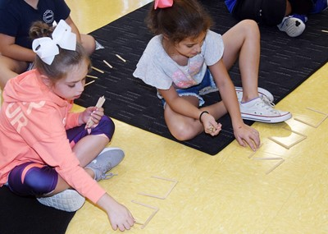
2
Spice It Up with Leveled Instruction…Younger Students
Rhythm Unit – Concept: Writing Rhythm Patterns Standard: ESGM1.PR.3 a
Leveled Instruction:
(Remediation) Level 1 – Use popsicle sticks to create 4 beat rhythms with teacher assistance.
(Advancing) Level 2 – Use popsicle sticks to create 4 beat rhythms alone. Create 4 different patterns.
(On Level) Level 3 – Use popsicle sticks to create 4 beat rhythms alone. Create 8 different patterns.
(Above Level) Level 4 - Use popsicle sticks to create 4 beat rhythms alone. Create one pattern that begins with a ta, one pattern that begins with a ti ti, one pattern that begins with a rest, one pattern that ends with two ta’s, one pattern that has two rests in the middle, one pattern that ends with two ti ti’s, one pattern that begins with a ta and ends with a ta, and one pattern that doesn’t have a rest!

Slide 28
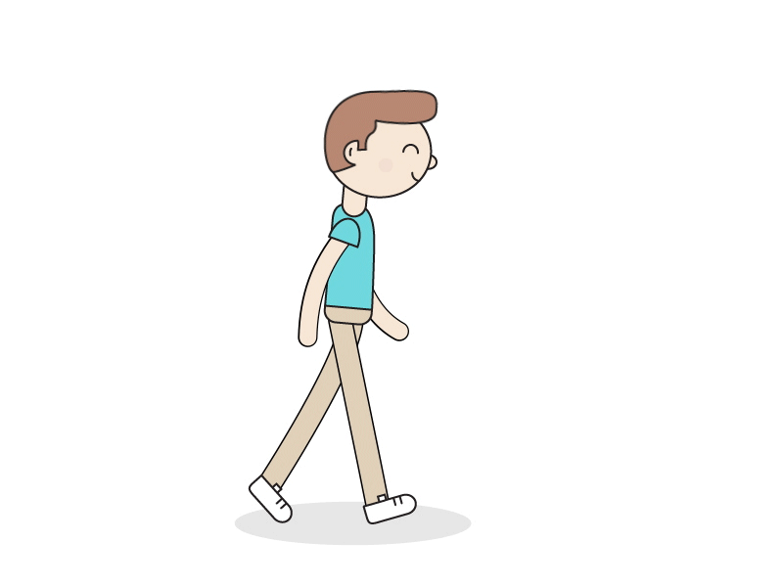
3
Spice It Up with Leveled Instruction
Rhythm Unit – Concept: Steady Beat / Rhythm Standard: ESGM5.PR.3 a
Leveled Instruction:
(Remediation) Level 1 – Walk the steady beat.
(Advancing) Level 2 – Walk the steady beat and perform the basic rhythmic pattern Pat, Clap, Clap, Snap, Rest (ta, titi, ta, sh)
(On Level) Level 3 –Walk the steady beat and perform the complex rhythmic pattern Pat 4X, Clap 2X, Snap L, Snap R, Clap (tiri tiri, titi, titi, ta)
(Above Level) Level 4 –Walk the steady beat and improvise complex rhythm patterns using sixteenth note, barred eighth note, quarter note, and quarter rest patterns!

Slide 29
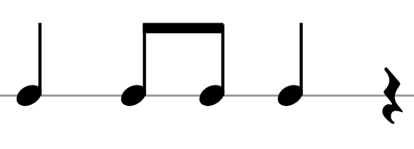
1 – Walk the steady beat.
2 – Walk the steady beat and perform the basic rhythmic pattern
P Cl Cl Sn R
3 –Walk the steady beat and perform the complex rhythmic pattern Pat 4X, Clap 2X, Snap L, Snap R, Clap (tiri tiri, titi, titi, ta)
P P P P Cl Cl Cl Cl Sn
4 –Walk the steady beat and improvise complex rhythm patterns using sixteenth note, barred eighth note, quarter note, and quarter rest patterns!

Slide 30
LEVELED INSTRUCTION
MELODY

Slide 31
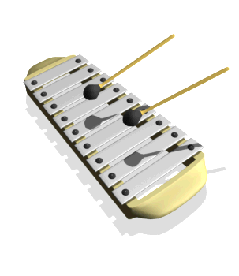
4
Spice It Up with Leveled Instruction
Rhythm Unit – Concept: Orff Instrumentation Standard: ESGM5.PR.2 b
Leveled Instruction:
Directions: Take a copy of your part. Read the rhythm patterns for your part. Practice the part with your fingers on the instrument. When you can play the part successfully with your fingers, raise your hand to show the teacher you are ready. Once you have passed off your part, you can take two mallets and rehearse your part using the back of the mallets. Be sure to keep a steady beat!
(Remediation) Level 1 – Take a copy of the Bass Metallophone part.
(Advancing) Level 2 – Take a copy of the Glockenspiel part.
(On Level) Level 3 – Take a copy of the Alto Metallophone part.
(Above Level) Level 4 – Take a copy of the Soprano Metallophone part.

Slide 32
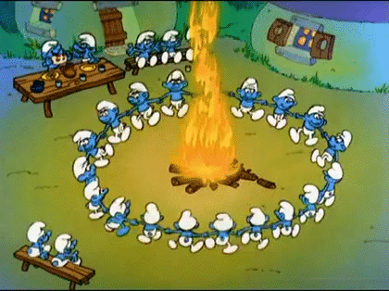
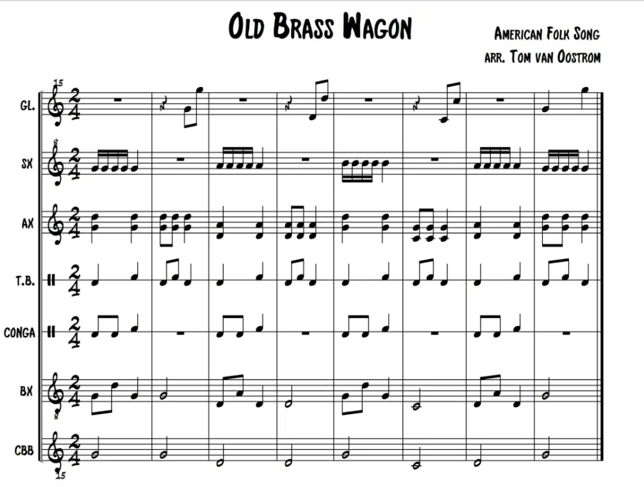

Slide 33
5
Spice It Up with Leveled Instruction
Rhythm Unit – Concept: Note Names Standard: ESGM4.PR.3 b
Leveled Instruction:
(Remediation) Level 1 – Take a card from the stack. Find the matching note on the music staff rug. Toss your beanbag to the correct note.
(Advancing) Level 2 – Find a partner. Use the matching cards. Match each note with its letter name card. (1 set of cards)
(On Level) Level 3 – Find a partner. Use the sorting trays. Sort the cards into the matching letter names. After practicing, have a competition and see who can sort the cards the fastest! (2 sets of cards)
(Above Level) Level 4 – Take one melody bell, mallets, and a song sheet. Fill in the letter names of the three songs. Play each song using the back of your mallets. Can you name the songs?

Slide 34
LEVELED INSTRUCTION
INSTRUMENTAL
FAMILIES

Slide 35
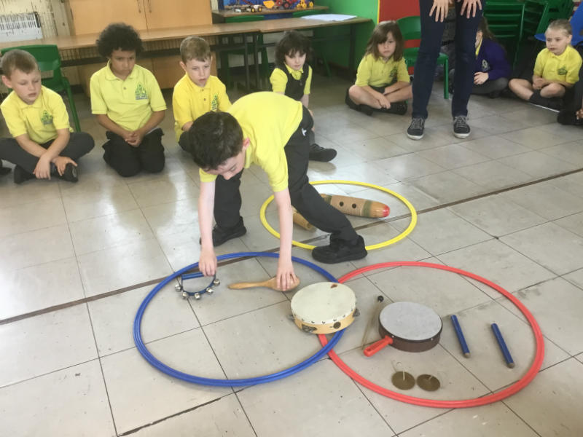
6
Spice It Up with Leveled Instruction
Rhythm Unit – Concept: Rhythm Instrument Families Standard: ESGM1.RE.1 c
Wood, Metal, Shaker/Scraper, Membrane
Students work as a group with instruments and hula hoops labeled with family names.
Leveled Instruction:
(Remediation) Level 1 – Sort only metal and shaker/scraper instruments into two families.
(Advancing) Level 2 – Sort 8 basic instruments into four families.
(On Level) Level 3 – Sort 8 basic and 4 new instruments into four families.
(Above Level) Level 4 – Sort 12 instruments including instruments who have not been introduced into four families.

Slide 36
LEVELED INSTRUCTION
MUSICAL
ELEMENTS

Slide 37
7
Spice It Up with Leveled Instruction
Rhythm Unit – Concept: Vocal Timbre Standard: ESGM5.RE.1 e
Soprano/Alto/Tenor/Bass
Leveled Instruction:
(Remediation) Level 1 – What voice type do you have? Write the names of two students in your class who you think have the same voice type as you. Interview them and ask which type of voice they think they have!
(Advancing) Level 2 – What voice type do you have? Which voice type do you like the best? Does anyone in your family have your favorite voice type? Interview them this week and ask which type of voice they think they have!
(On Level) Level 3 – What voice type do you have? Write which voice type all the people in your family have. Don’t forget your grandparents! Interview them this week and see if you were correct!
(Above Level) Level 4 – What voice type do you have? Name one person who works in our school that has a bass voice, one who has a tenor voice, one who has an alto voice, and one who has a soprano voice. Think of your favorite famous singer. What voice type do they have? How do you know?

Slide 38
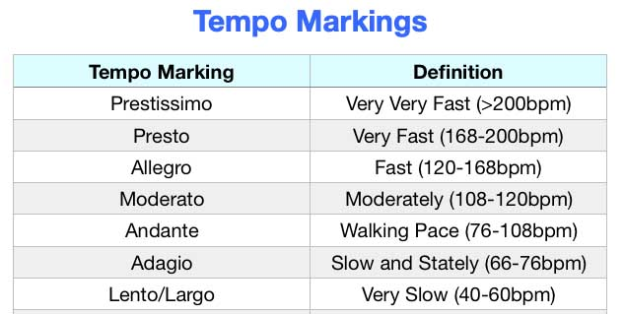
8
Spice It Up with Leveled Instruction
Rhythm Unit – Concept: Tempo Standard: ESGM3.RE.1 b
Play “Hot Cross Buns” on the recorder.
Leveled Instruction:
(Remediation) Level 1 – Practice playing the song Adagio and Allegro. Make sure we can tell the difference between your tempo markings when you perform for the class!
(Advancing) Level 2 – Practice playing the song Lento, Andante, and Presto. Make sure we can tell the difference between your tempo markings when you perform for the class!
(On Level) Level 3 – Practice playing the song beginning Lento and moving up the chart all the way to Prestissimo. As you are playing, we are going to guess when you move from one tempo marking to the next!
(Above Level) Level 4 – Take a paper and pencil and write out a pattern of tempo markings. Practice playing the song using each marking. Don’t let anyone see your choice of markings. When you play for the class, we are going to try to guess your pattern!

Slide 39
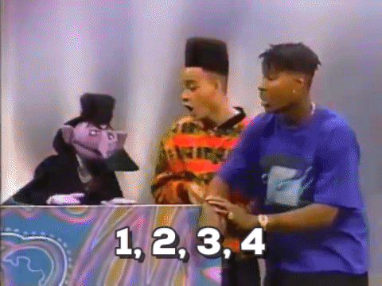
KAHOOT BREAK!!!!
WHICH LEVEL IS THIS ACTIVITY?
https://create.kahoot.it/my-library/kahoots/662c2c38-19ac-40bf-94f7-45601d9638ed

Slide 40
LEVELED INSTRUCTION
MOVEMENT

Slide 41
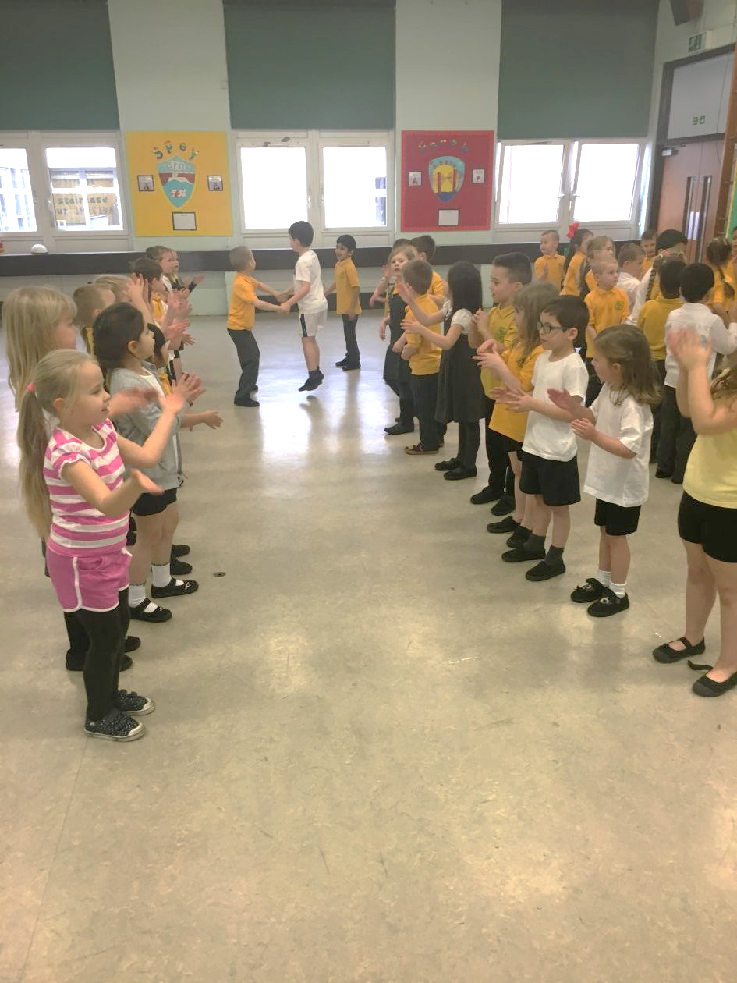
9
Spice It Up with Leveled Instruction
Rhythm Unit – Concept: Reel in A B Form Standard: ESGM2.RE.3 c
Everyone will be working in small groups.
Leveled Instruction:
(Remediation) Level 1 – Choreograph a simple Reel with at least two different movement patterns.
(Advancing) Level 2 – Choreograph a simple Reel with at least four different movement patterns.
(On Level) Level 3 – Choreograph a Reel with at least six different movement patterns.
(Above Level) Level 4 – Choreograph a simple Reel with at least six different movement patterns. You must include a traveling pattern that gives everyone time to return to their home spot!
Practice your dance and be ready to perform it for the class!

Slide 42
LEVELED INSTRUCTION
PERFORMANCE ETIQUETTE

Slide 43
10
Spice It Up with Leveled Instruction
Rhythm Unit – Concept: Performance Etiquette Standard: ESGM2.CN.2 c
Leveled Instruction:
(Remediation) Level 1 – Why are performance etiquette rules important? Work with the teacher to shorten the rules and create a cheer to help everyone memorize the rules! Practice your cheer and be ready to perform for the class.
(Advancing) Level 2 – Make a large performance etiquette poster in a small group. Be sure to use at least 4 different rules. Be ready to present your poster to the class. Make your poster nice and colorful….we will hang it in the hallway!
(On Level) Level 3 – Write a performance etiquette rap in a small group. Be sure to use at least 4 different rules. Practice your rap and be ready to perform it for the class. Some people in your group can make the sound effects!
(Above Level) Level 4 – Write a skit about performance etiquette in a small group. Be sure to use at least 4 different rules. Show what happens when a person follows the rules and also what happens when they break the rules! Practice your skit and be ready to perform it for the class.

Slide 44
LEVELED INSTRUCTION
FORM

Slide 45
11
Spice It Up with Leveled Instruction
Rhythm Unit – Concept: Form and Movement Standard:
Leveled Instruction:
(Remediation) Level 1 – Choreograph a different fun pattern using your ribbon wand for each section of the song… A, B, and C in a small group. Draw your movements into the form boxes.
(Advancing) Level 2 – Choreograph a different fun pattern using your ribbon wand for each section of the song… A, B, and C alone. Draw or write your movements into the form boxes.
(On Level) Level 3 – Create a different fun pattern using your ribbon wand for each section of the song… A, B, and C alone. Include high, low, fast, and slow movements. Draw or write your movements into the form boxes.
(Above Level) Level 4 – Create a different fun pattern using your ribbon wand for each section of the song… A, B, and C alone. Include high, low, fast, slow, forward, backward, and spinning movements. Don’t repeat any of the movements! Draw or write your movements into the form boxes.

Slide 46
Nearpod Code
R5MNW
(Remediation) Level 1 – Choreograph a different fun pattern using your ribbon wand for each section of the song… A, B, and C in a small group. Draw your movements into the form boxes.
(Advancing) Level 2 – Choreograph a different fun pattern using your ribbon wand for each section of the song… A, B, and C alone. Draw or write your movements into the form boxes.
(On Level) Level 3 – Create a different fun pattern using your ribbon wand for each section of the song… A, B, and C alone. Include high, low, fast, and slow movements. Draw or write your movements into the form boxes.
(Above Level) Level 4 – Create a different fun pattern using your ribbon wand for each section of the song… A, B, and C alone. Include high, low, fast, slow, forward, backward, and spinning movements. Don’t repeat any of the movements! Draw or write your movements into the form boxes.

Slide 47
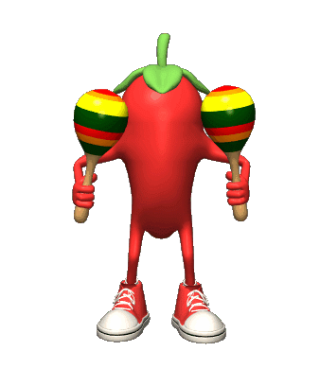
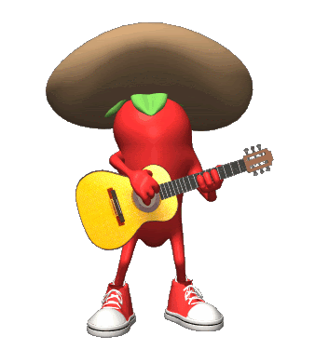
Would anyone like to share a leveled instruction idea? Does anyone have a question for us?

Slide 48
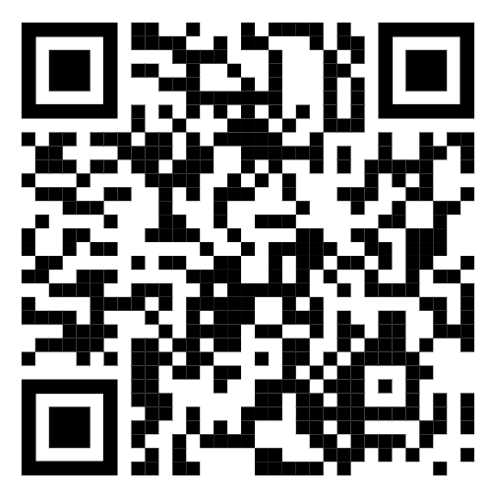
You can find today’s presentation at​
www.mrsahmadsmusicnotes.weebly.com​
​
If you have questions, would like help with a lesson, or would like to share your great ideas…please contact us!​
​
Megan Endicott endicott@fultonschools.org #EndicottSpot​
Susan Ahmad ahmad@fultonschools.org #LWEMusicNotes

Slide 49
Rhythm
Spice It Up with Leveled Instruction…Older Students
Rhythm Unit – Concept: Writing Rhythm Patterns Standard: ESGM5.PR.3 a
Leveled Instruction:
(Remediation) Level 1 – Write a four-measure rhythm pattern in 4/4 meter using quarter notes, barred eighth notes, barred sixteenth notes, half notes, and quarter rests. (Review from previous year.)
(Advancing) Level 2 – Write a four-measure rhythm pattern in 4/4 meter using quarter notes, barred eighth notes, barred sixteenth notes, half notes, quarter rests, half rests, and dotted half notes.
(On Level) Level 3 – Write a four-measure rhythm pattern in 4/4 meter using quarter notes, barred eighth notes, barred sixteenth notes, half notes, quarter rests, half rests, dotted half notes, dotted quarter notes, and single eighth notes.
(Above Level) Level 4 – Write a four-measure rhythm pattern in 4/4 meter, and a four-measure rhythm pattern in 3/4 meter using quarter notes, barred eighth notes, barred sixteenth notes, half notes, quarter rests, half rests, dotted half notes, dotted quarter notes, and single eighth notes. Bonus: Try to create a syncopated rhythm pattern!

Slide 50
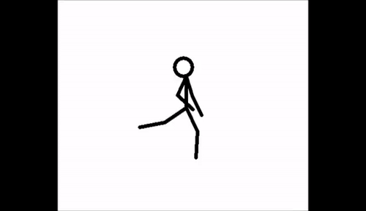
Melodic Direction
Spice It Up with Leveled Instruction
Rhythm Unit – Concept: Melodic Direction Standard: ESGM3.RE.3 a
Leveled Instruction:
(Remediation) Level 1 – Draw pictures of two movements you can use to show when the music sounds high and two movements you can use to show when the music sounds low. Practice your movements.
(Advancing) Level 2 – Draw pictures of four movements that show the melodic direction of the listening selection. One movement should show high, one low, one upward and one downward. Practice your movements.
(On Level) Level 3 – Take a copy of the listening map. Write in movements that show each of the melodic patterns. Practice your movements.
(Above Level) Level 4 - Take a copy of the listening map. Write in different movements for each of the melodic patterns: upward, downward, stays the same. Be sure to include really high and really low movements! Create some movements for your feet, legs, hands, head, shoulders, and hips! Practice your movements.

Slide 51
1 2 3 4
1 2 3 4
1 2 3 4
1 2 3 4
Accents
Spice It Up with Leveled Instruction (Younger Grades)
Rhythm Unit – Concept: Steady Beat / Accents Standard: ESGM2.PR.2 a
Leveled Instruction:
(Remediation) Level 1 – Create 4 flashcards that match the cards in the teacher example.
(Advancing) Level 2 – Create 4 different flashcards that have two large numbers and two small numbers.
(On Level) Level 3 – Create 6 different flashcards that have a combination of one large number and two large numbers.
(Above Level) Level 4 – Create 8 different flashcards that have a combination of one large number, two large numbers, and three large numbers.
Step 1: Practice playing each flashcard on your drum. Step 2: Put two flashcards together and play both patterns. Step 3: Put three flashcards together and play the patterns. Step 4: Place all your flashcards in a row and practice playing the patterns. Step 5: Mix the cards up and play the new patterns. Step 6: Perform your patterns with music.

Slide 52
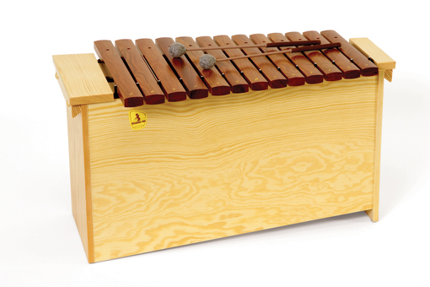
Form
Spice It Up with Leveled Instruction
Rhythm Unit – Concept: Form (Accompaniment vs. Improvisation) Standard: ESGM3.PR.2 c
Leveled Instruction:
(Remediation) Level 1 – Play a chord bourdon (open 5th) with a steady beat during the A section of the song and improvise a melody using the Pentatonic scale during the B section of the song.
(Advancing) Level 2 – Play a broken bourdon (1-5) with a steady beat during the A section of the song and improvise a melody using the Pentatonic scale during the B section of the song.
(On Level) Level 3 – Play a cross over bourdon (1-5-8-5) with a steady beat during the A section of the song and improvise a melody using the Pentatonic scale during the B section of the song.
(Above Level) Level 4 – Play a cross over bourdon (1-5-8-5) with a steady beat during the A section of the song and improvise a melody using the Pentatonic scale during the B section of the song. Incorporate eighth notes, sixteenth notes, and syncopation into your improvised B section.

Slide 53
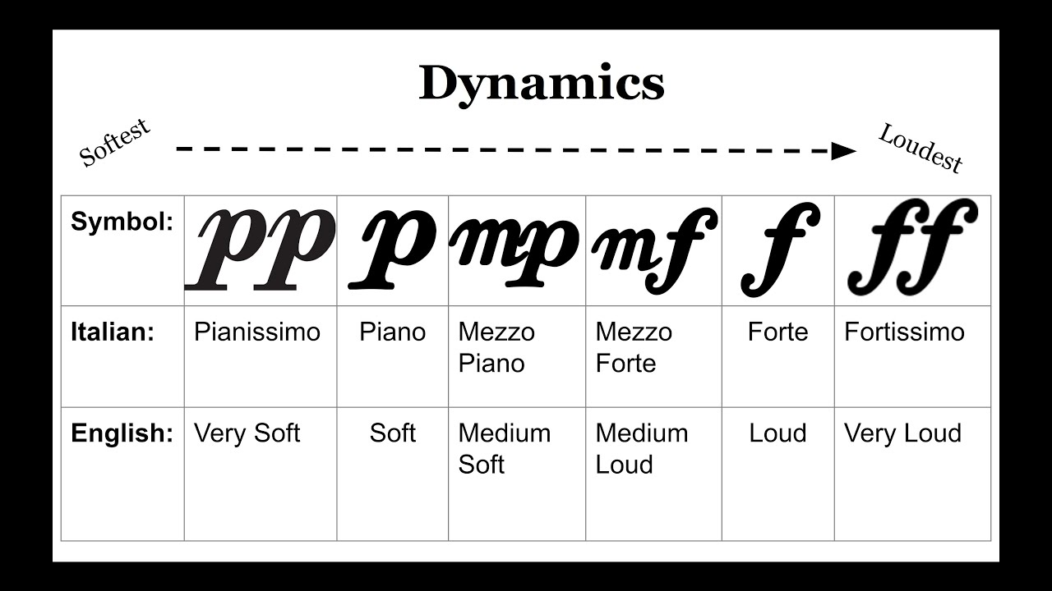
Dynamics
Spice It Up with Leveled Instruction
Rhythm Unit – Concept: Dynamics Standards: ESGM4.RE.1 b
Fill in dynamic markings and perform song. ESGM4.PR.1 a
Take a copy of the song “The Lion Sleeps Tonight”
Sing the song, group in sets of 2 or 3 students, add dynamic markings to the song, practice and be ready to perform your version for the class.
Leveled Instruction:
(Remediation) Level 1 – Use piano, forte, pianissimo, fortissimo, mezzo piano, and mezzo forte
(Advancing) Level 2 – Use piano, forte, pianissimo, fortissimo, mezzo piano, mezzo forte, crescendo, and diminuendo
(On Level) Level 3 – Use piano, forte, pianissimo, fortissimo, mezzo piano, mezzo forte, crescendo, diminuendo, and sforzando
(Above Level) Level 4 – Use all dynamic markings. Each verse must have different dynamic patterns!

Slide 54
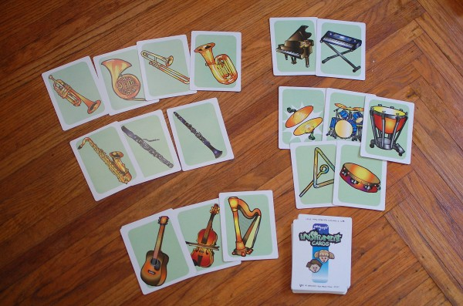
Orchestral Instruments
Spice It Up with Leveled Instruction
Rhythm Unit – Concept: Orchestral Instrument Families Standard: ESGM5.RE.1 c
Leveled Instruction:
(Remediation) Level 1 – Sorting basic Brass and Woodwind instruments only
(Advancing) Level 2 – Sorting basic Brass, Woodwind, String, and Percussion instruments
(On Level) Level 3 – Sorting basic and advanced Brass, Woodwind, String, and Percussion instruments
(Above Level) Level 4 – Sorting all Orchestral instruments and World instruments

