Slide 1
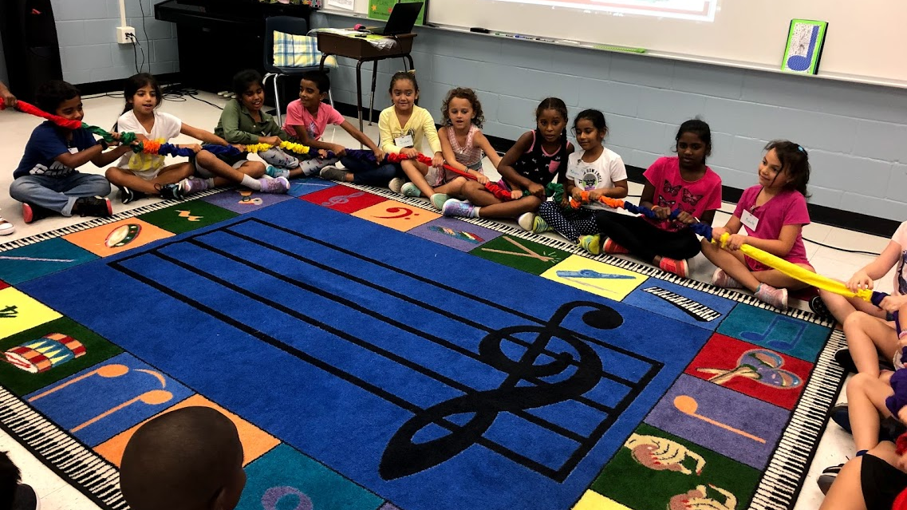
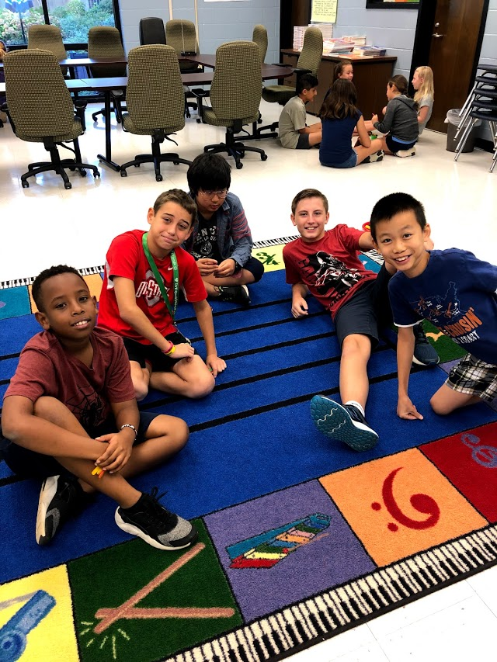
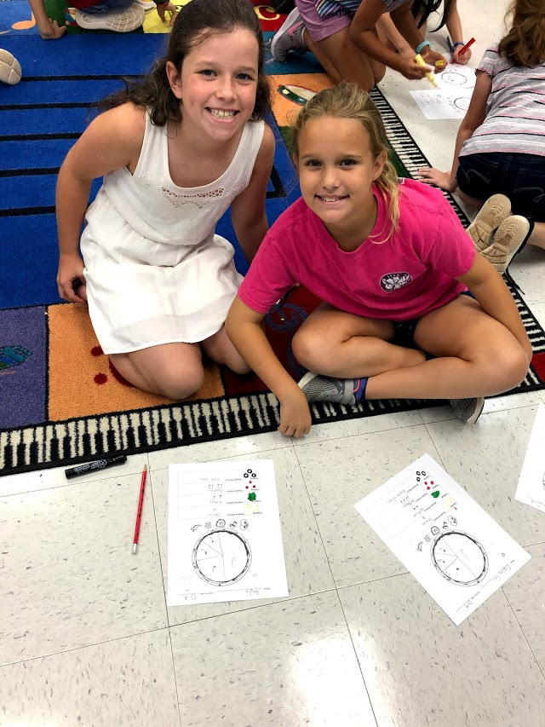
Mrs. Ahmad’s
Music Notes
Classroom Management
Strategies
That Work!

Slide 2
BUILDING A STRONG FOUNDATION
MONITORING STUDENTS
THE ACTION PLAN
PROBLEM SOLVING

Slide 3
BUILDING A STRONG FOUNDATION

Slide 4
Creating Rules
Rules inform students of the behavior that is expected of them
Use 3-5 rules only (so they can remember them)
Rules should be positive
Rules should be clear and specific

Slide 5
Creating Rules
Get the class involved (ask students for suggestions….or examples for rules)
Post rules or create a PowerPoint slide to personalize your rules for each class
Chant the rules, rap the rules, or sing the rules…this will help them remember the rules better

Slide 6
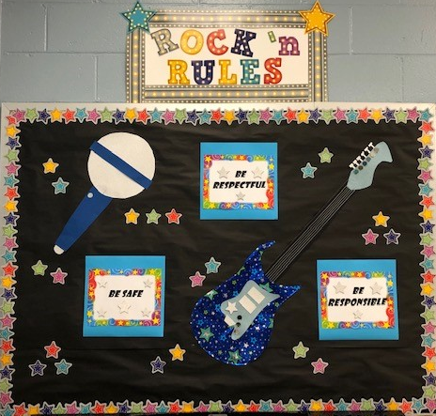
Classroom Rules School Rules
Music Rules... 1. Be Safe 2. Be Responsible 3. Be Respectful
What does that look like
in the music classroom? 1. Be Safe…use equipment properly 2. Be Responsible…participate, listen, and follow directions 3. Be Respectful…show respect for others

Slide 7
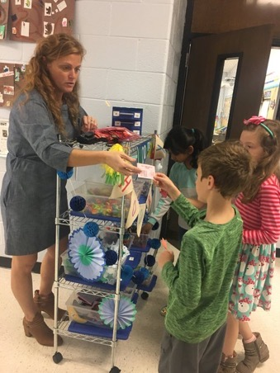
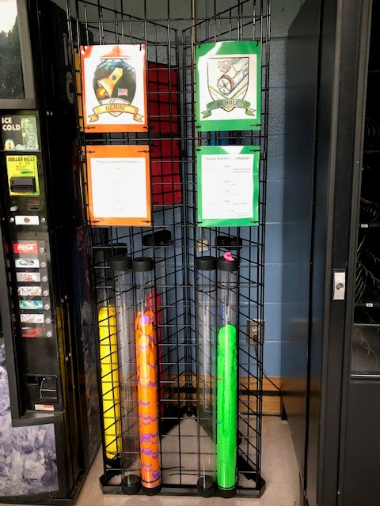
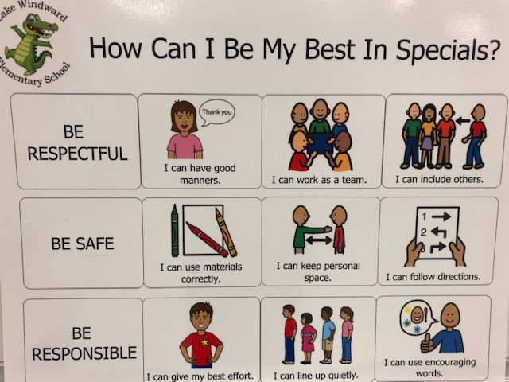
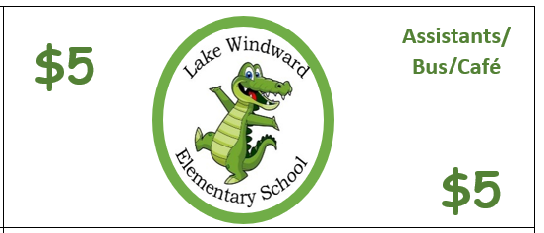
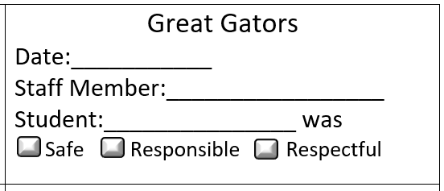
Great Gator
Result – Less office referrals at our school!

Slide 8
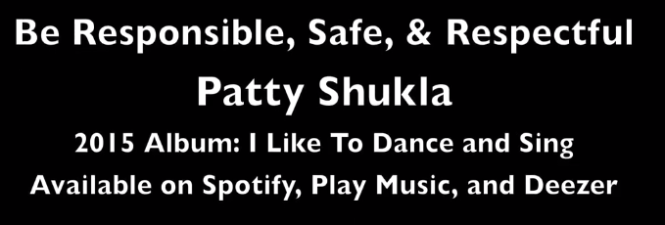
Create a Video
https://safeYouTube.net/w/6EqA

Slide 9
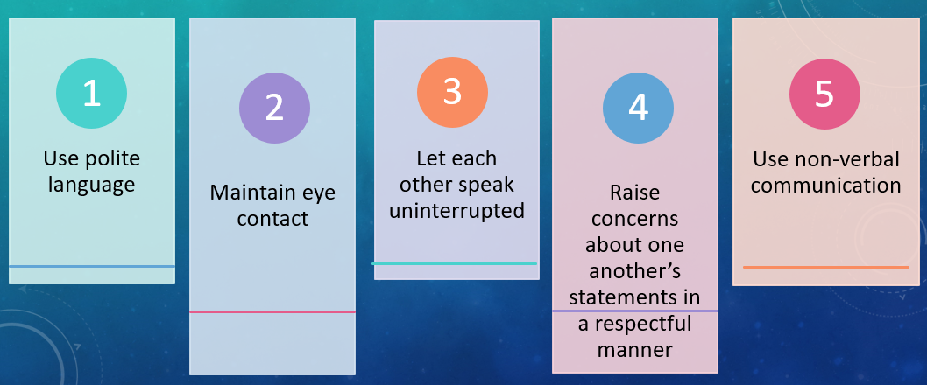
Behavior Modeling
Practice doing these with your students!

Slide 10
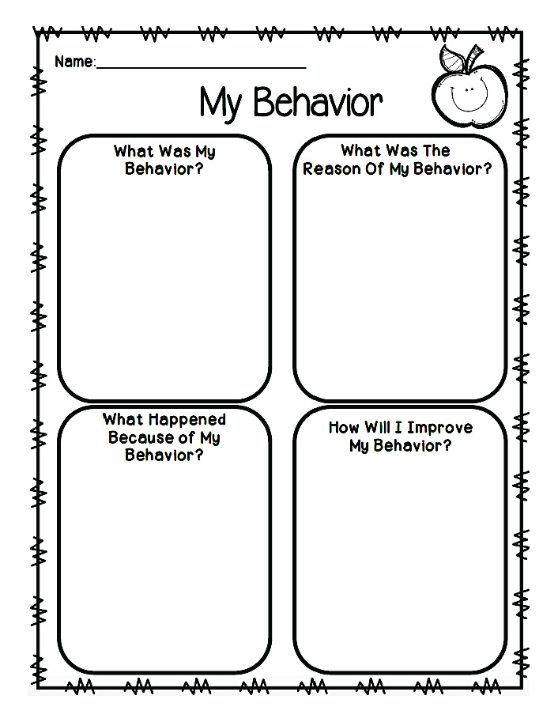
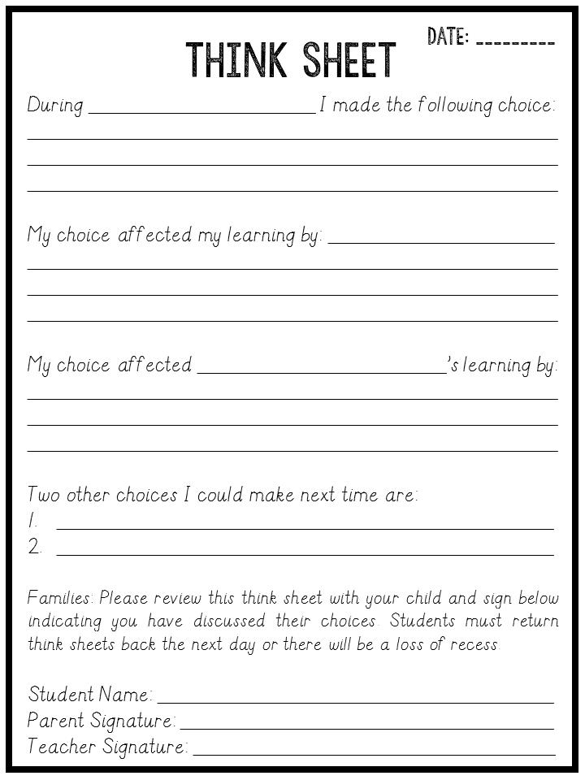
Track Behavior (specific details about behavior, date, time, location, any others involved, what they said, what you said …word for word, have student sign the form…should keep in a folder that is stored out of sight or even better in a digital folder)

Slide 11
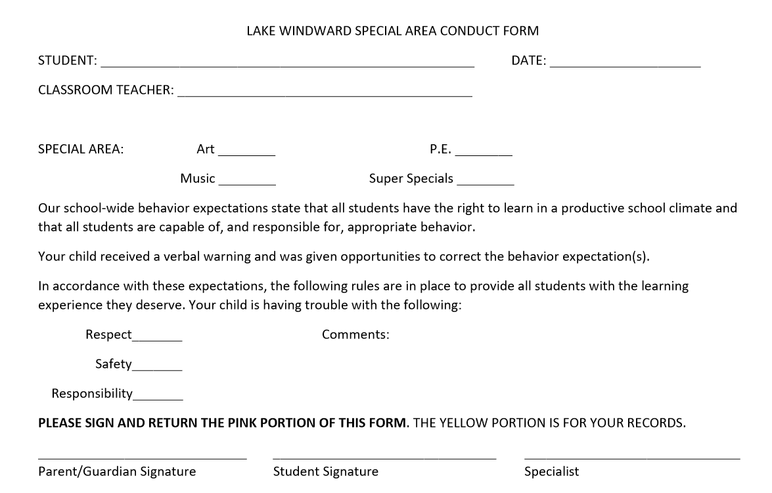

Slide 12
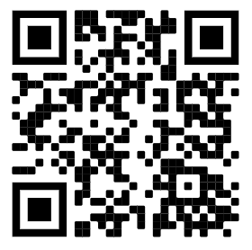
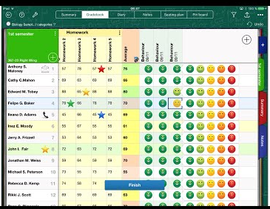
https://www.idoceo.net/index.php/en/
Teacher Gradebook and Planner App for iPad

Slide 13
Take a
Poll

Slide 14
MONITORING STUDENTS

Slide 15
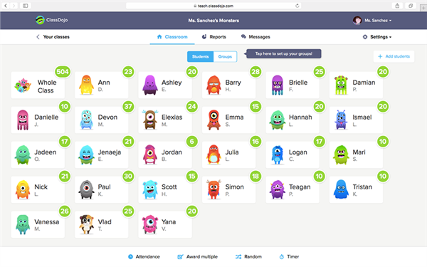
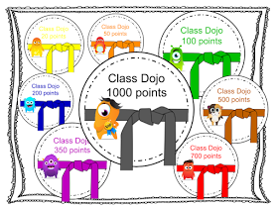
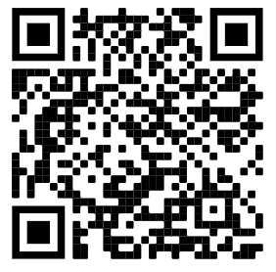
Behavior Monitoring Whole Class Always positive
DOJO KARATE
https://amazingdaysatschool.blogspot.com/search/label/Class%20Dojo

Slide 16
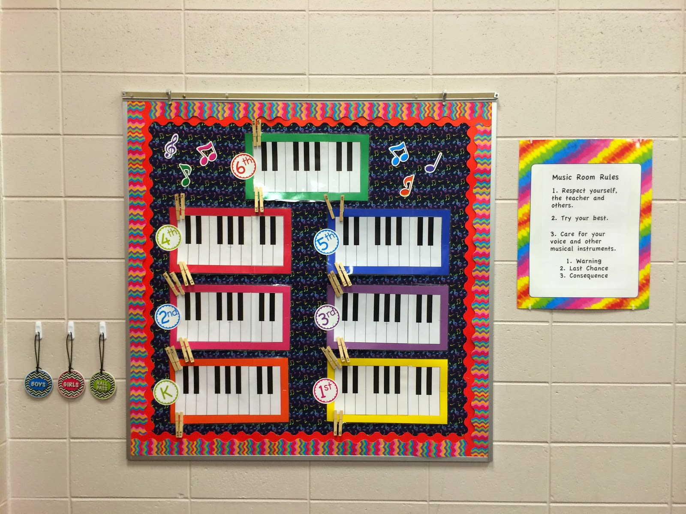
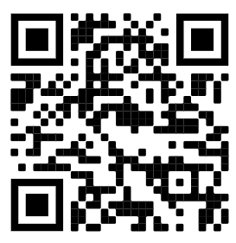
Behavior Monitoring Whole Class always positive
amusicteachersjourney.blogspot.de

Slide 17
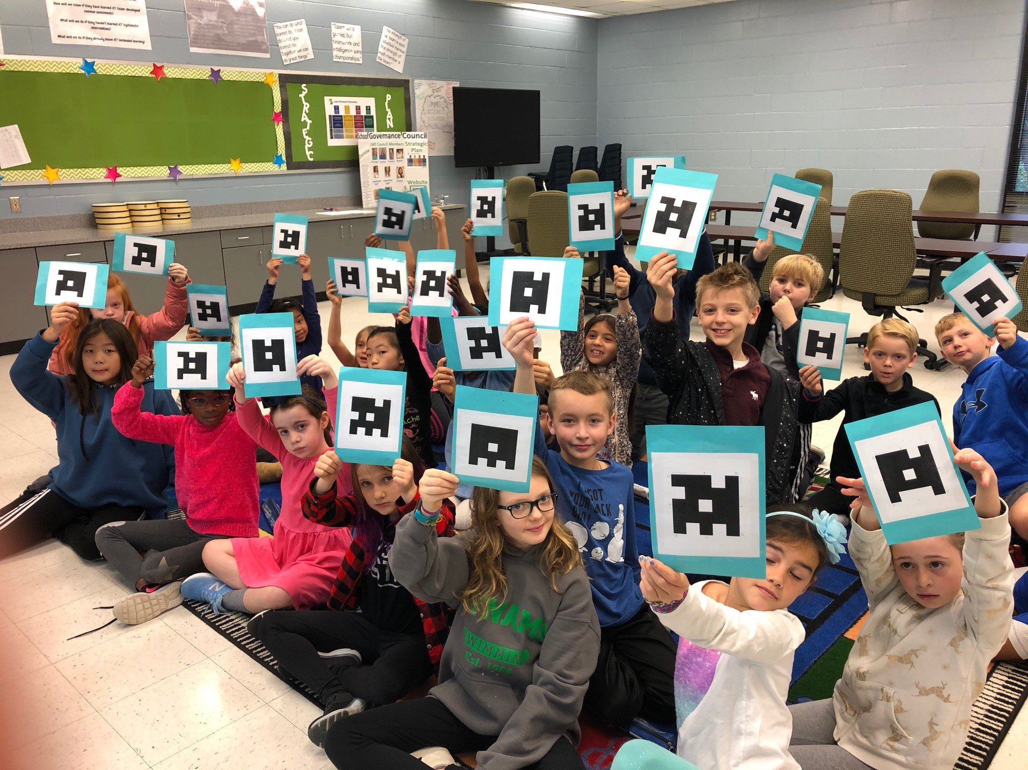
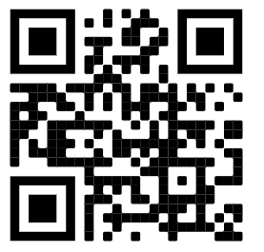
Behavior monitoring Self MONITORING
https://www.plickers.com/

Slide 18
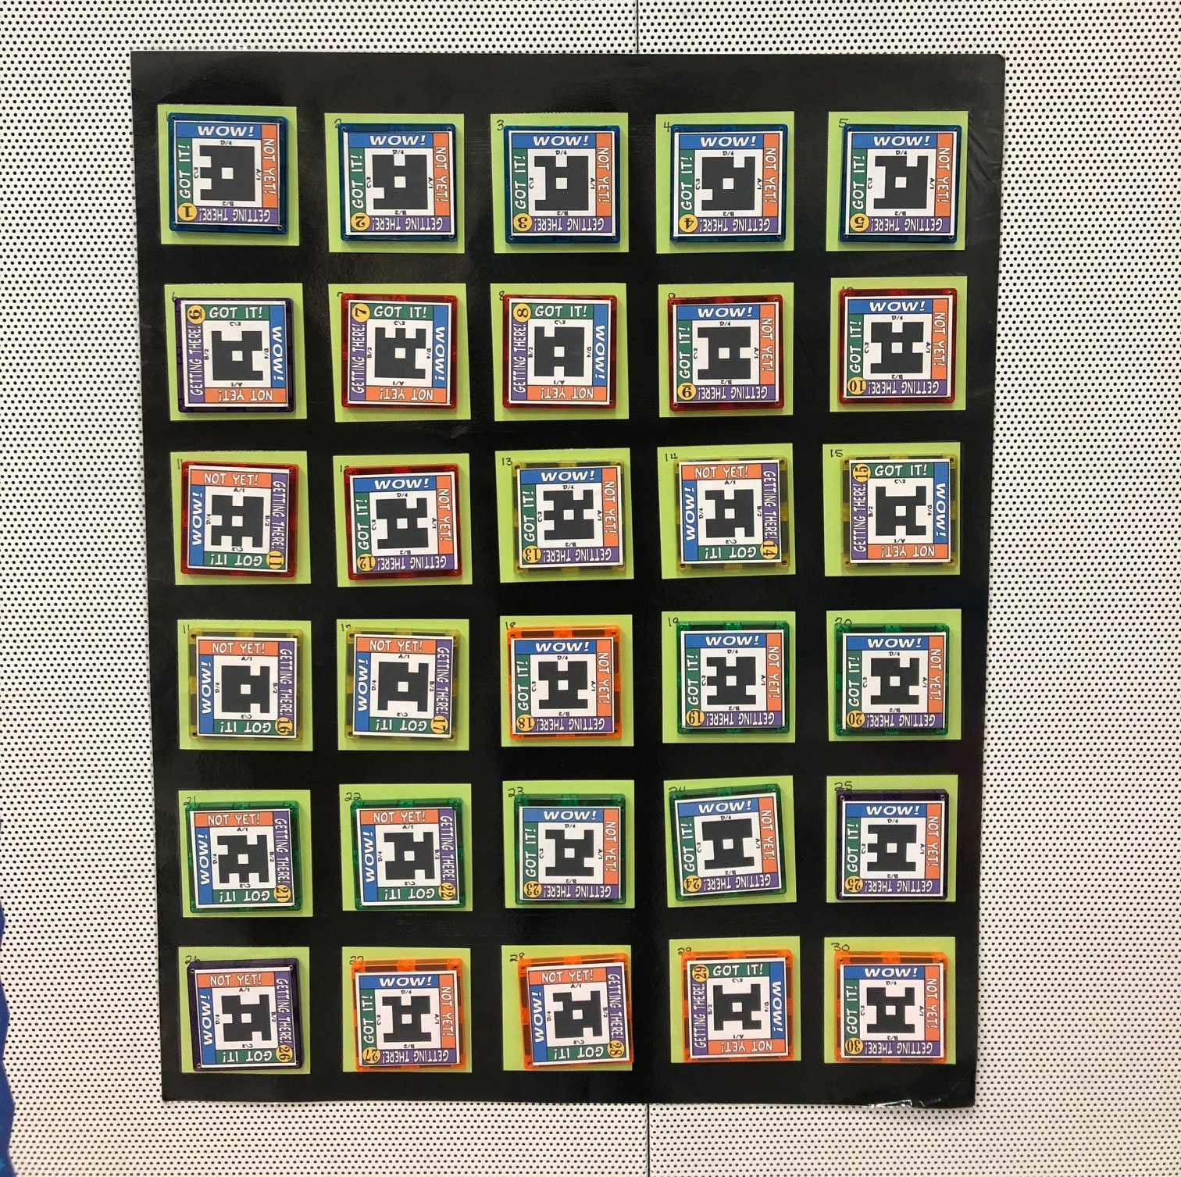
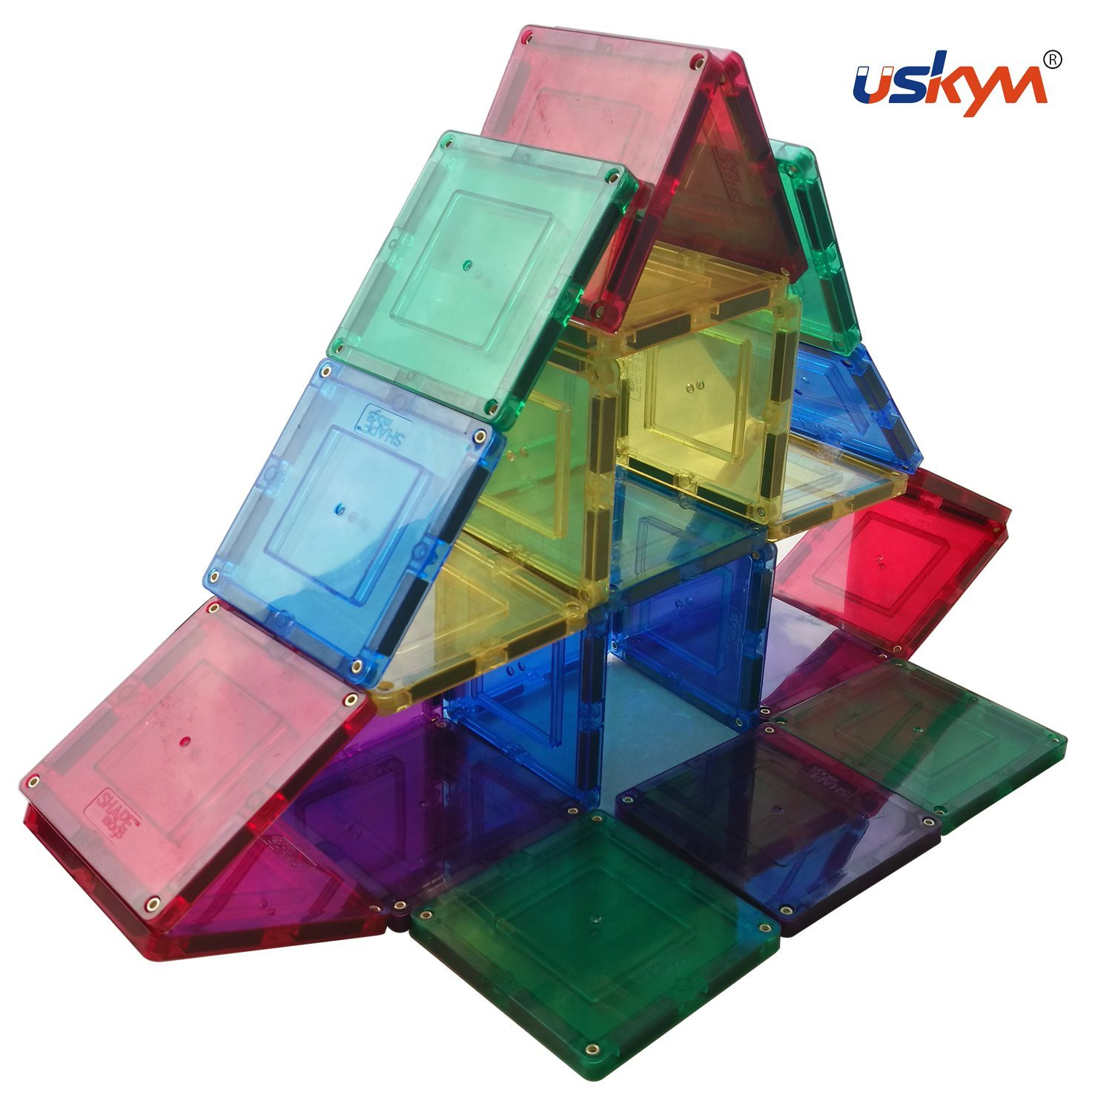
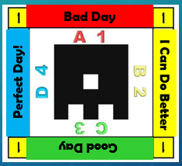
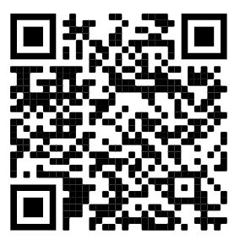
Behavior monitoring Self MONITORING Plagnets
https://www.physeddepot.com/plickers-magnets-plagnets.html

Slide 19
https://www.physeddepot.com/plickers-magnets-plagnets.html

Slide 20
Use the letters for the word MUSIC (or MUSICIAN). Clap or sing a pattern (or use a hand sign) and if students are listening and still, they get a letter. If they spell the word before the end of class on four different weeks, they get a class reward. Let the students help you think of rewards. Keep them simple.

Slide 21
Whole class: sing a favorite song; play a “music game”; freeze dance; playing instruments; an interactive whiteboard activity etc…
It could even be an activity that is part of your lesson but you save it for the end of the lesson and call it a “reward.”
Individual: treasure box, book corner, class helper, play a special instrument, sit in a special chair, special paper award to take home…

Slide 22
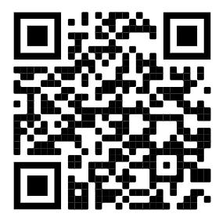
Padlet
Break
https://padlet.com/ahmad5/72glepqcmshylerx
I know you have some amazing ways to track student discipline!
You can post your own creative ideas or post pictures and links to things you have found on the internet! Once you get to the Padlet, make it a favorite so you can return later and see everyone’s amazing ideas.
I have loaded the ones I shared today!

Slide 23
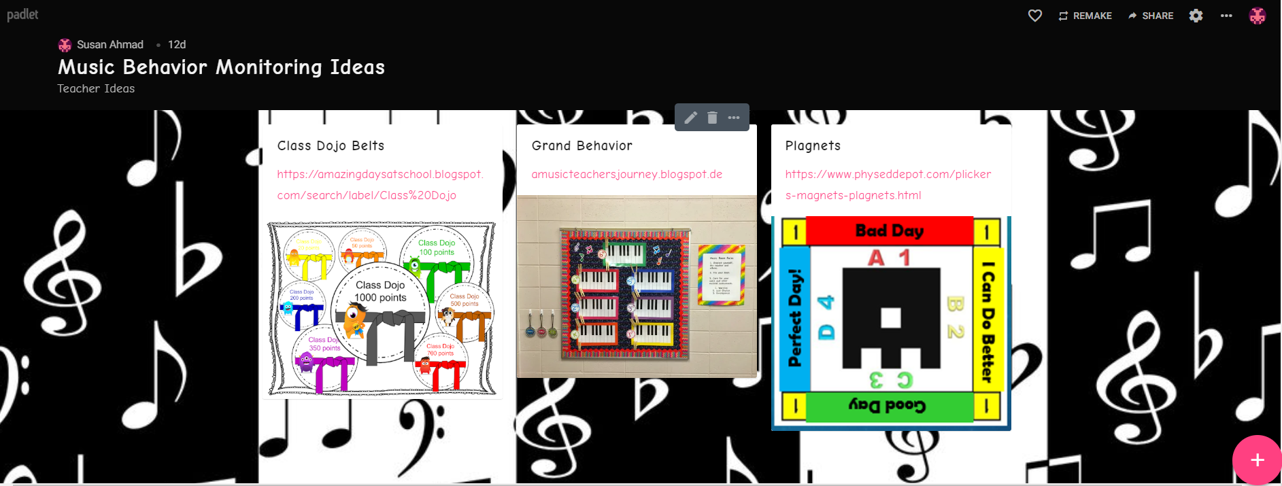

Slide 24
Question
Break
Questions and Poll Results

Slide 25
THE ACTION PLAN

Slide 26
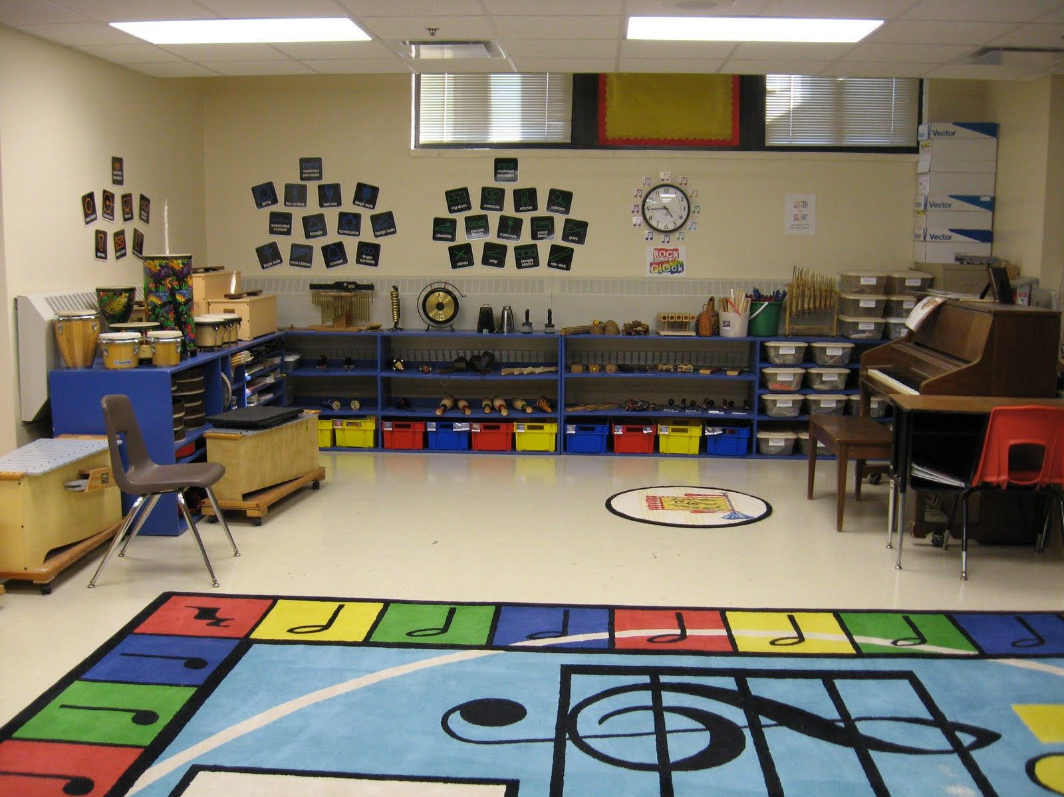
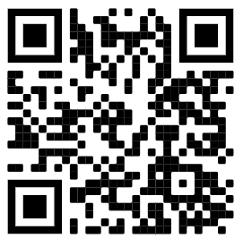
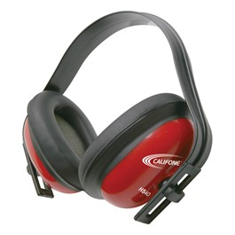
Classroom
https://www.decorativelightcovers.com/
Students have their own space
Optional Seating…separate rug, special chair, beanbag
Dim light during lesson (Octo Lights)
Create a Quiet Zone…. used for Time Out or just to take a break
and refocus….use small gadgets to play with while there
Headset for when it gets too noisy

Slide 27
procedures
Group activity procedures (how groups are selected, signal for
attention, cooperating, everyone contributes, managing time)
Rules while assessing and completing work
Things to do when they finish early (work folders, music games)

Slide 28
Lesson Plans
Hook - build excitement for content (mystery item, theme, prop, “Guess what we are studying?”)
Varying mediums – different activities focused on one theme….movement, singing, instruments, creating, performing, responding, and connecting
Students Invested - when you begin a new unit, have students post what they are interested in learning about based on the new topic
Engaging - add humor, jokes, props, and fun songs to a lesson
Challenging Work - don’t overwhelm, but also don’t underwhelm your students with work assignments…and allow plenty of time for completion

Slide 29
Lesson Plans
Differentiate – use varying strategies and techniques... PowerPoint, videos, graphics, technology, physical objects (props), worksheets, projects, centers…
Inquiry Based Learning - Ask lots of questions to get students involved
Group work - write student contracts, assign tasks to each student, review rules before starting
Informal assessments - use results to group students for leveled activities and even reteaching the material…so everyone is successful

Slide 30
PROBLEM SOLVING

Slide 31
Student Needs
Children like to have structured control…create choice boards to help students feel like they have more control.
Children want to belong….create safe groups for students, even if one child chooses to be your partner.
Children want to have fun.
Some students just need a little extra attention.

Slide 32
What’s the problem?
Unclear limits
Want attention
Boredom
To avoid work
Home issues
Unsure of what you are asking them to do
Remember….many of their problems aren’t about you!!!!

Slide 33
Addressing students
Avoid hesitation when you must address bad behavior, especially when a student breaks a documented rule.
Acting sooner rather than later will help ensure that negative feelings — whether between students or you and a student — won’t fester. Failure to act can result in more poor behavior, leading to needlessly-difficult conversations.
Keep in mind: It’s best to talk to the student in private if possible.
Remind the student consequences are not personal they are cause and effect.
Explain what you saw and state the consequences….email parents, Time Out, move seats, conference with student, conference with student and classroom teacher, loss of privileges.

Slide 34
minor
Disruptive
behaviors
Tapping, Talking, Giggling, Touching Others, Funny Comments
What to do? What not to do?
Stand in front of the student Don’t stop teaching
Give them the “look” Don’t over-react
Call their name
Change their seat
Send them to “time out”
These offenses should be handled by you and if they occur every week…you should reach out to the classroom teacher, school counselor, and other special area teachers for advice and support. Try not to get the administration involved at this point.

Slide 35
minor
Disruptive
behaviors
Call out specific students in a positive manner. For example:
“Do you have a question?”, not “Stop talking and disrupting other students”
“Do you need help focusing?”, not “Pay attention and stop fooling around
while I’m talking”.
Address isolated behavior issues instead of punishing an entire class, as this
can hurt your relationships with other students who are on-task.
When you address a student, always give them time to respond to you.
Realize that they may really not know why they are acting the way they are!

Slide 36
chronic
Disruptive
behaviors
What to do…
Gradually increase the levels of consequence
Tell them their consequences are a direct response to their behavior
Collaborate a resolution with the student
Keep well documented notes on the frequency, what works, and what doesn’t work for that individual student
Speak with the Classroom Teacher
Speak with the School Counselor
Create a Behavior Contract (Check with classroom teacher to see if there is already one in place, include the student in the progress of creating the contract)
Get their parents involved or at least inform them

Slide 37
chronic
Disruptive
behaviors
What not to do…
Yell at the student
Touch the student
Argue with the student
Threaten to do things that you really aren’t going to do
Discuss one student with another student
***You can’t constantly press the student….give them chances each class to be successful***

Slide 38
major
Disruptive
behaviors
Endangering teachers and students…threats, fighting, damaging school property
What to do…
Check school policies
Check to see if the student has an IEP or 504 plan….read it, reach out to supporting teacher
Check for medical issues
Have a plan in case you need to move the class to safety
Ask administration for a code or buzz word so they will know that if you use that word or phrase that you need assistance immediately
Separate student from others

Slide 39
major
Disruptive
behaviors
Who to reach out to?
Inform classroom teacher
Inform parents of action and how you plan to deal with the situation
Inform administration
Speak with PAGE or your local teacher’s union

Slide 40
Destress
Deal with the situation before it has a chance to fester….take action within 24 hours of the infraction.
Think about what went wrong…and modify the lesson or activities if needed.
Take a couple of deep breathes and think about how you would want someone to treat you if you were having a bad day.
Try not to take things personally. The same child probably struggles in all their classes.
Apologize when you are wrong.
Don’t gossip about the situation with other teachers….instead spend time collaborating on ways to help the student and their family.
Walk around the room several times and prepare yourself to start fresh with the next class.

Slide 41
Question
Break
We will play our trivia game as soon as I answer questions!
Links Handout

Slide 42
Time to test your skills!
https://triviamaker.com/gamepreviewnew.php?game=GameData&screen=splash&gameid=20200512158930400982325

Slide 43
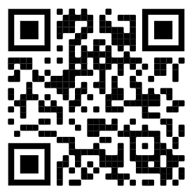
Classroom Management
Strategies
That Work!
Mrs. Ahmad’s
Music Notes
Susan Ahmad
susanahmad@yahoo.com
https://mrsahmadsmusicnotes.weebly.com
http://twitter.com/LWEMusicNotes
Thank You!

Slide 45
Encouraging Good Behavior
Take a survey of what each student enjoys doing and what their interests are.
Questions: Do you like to help the teacher?…..Do you like to sing?….Are you good at reading rhythms?... Do you like to dance?….Do you like to be the leader?… Do you get nervous when you are asked to do something in front of the class?... What is your favorite rhythm instrument?...What is your favorite subject?...What is your favorite sport?
This will come in handy when you need to encourage good behavior with a challenging student. (Make your first question “What is your name and who is your homeroom teacher?”)
Microsoft

